Slide 1
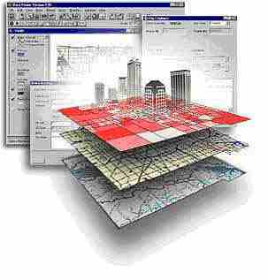
GSP 270
Vector Analysis II
Reading Assignment: Bolstad Chapter 9 (pp. 347-406)

Slide 2
“Standard” (IBM) Flow Charts
Start
- Start and End
?
- Decision
Process
- Process (something that changes the data)
Data Set
- Spatial or tabular data
- Shows the “Flow”

Slide 3
Flow Chart to Check SRS
Start
Is the
Coordinate
system defined?
No
Yes
Is the
coordinate system
correct?
Find out what the coordinate system is
Yes
No
No
Found it?
Yes
“Define” the coordinate system
Continue
Can’t use the data

Slide 4
Projecting Data
Start
Is the data in the desired SRS?
No
Yes
Project to desired SRS to “Working” folder
Copy the data to “Working” folder
Stop

Slide 5
Model Builder Flow Symbols
There is no “start” and “end” is really “pause”
?
- Decision
Process
- Process (something that changes the data)
Data
- Spatial or tabular data
- Shows the “Flow”
Note: The colors default to black and white and can be changed by the user

Slide 6
ArcMap Model Builder Symbols
Rivers
Buffer
Rivers
Buffer
Non
Harvestable
Trails
Buffer
Trails
Buffer
Union
Power lines
Power Line Buffer
Buffer
Erase
High
Slope
Slope
Reclass
High
Slope
Convert to
Vector
Total
Harvestable
Acres

Slide 7
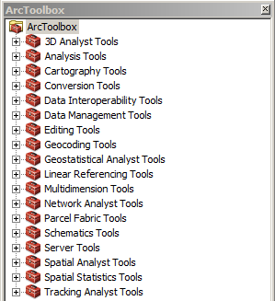
The Mighty and Dreaded Toolbox!
Take some time and get to know it

Slide 8
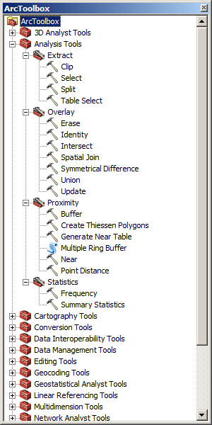
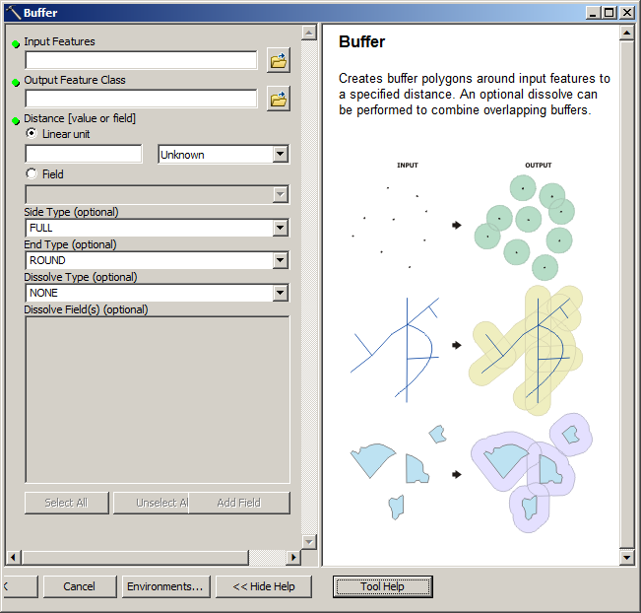
Vector Analysis

Slide 9
Finding Tools
Need to know the location or the name of the tool
  Union in a single layer -> “Dissolve”
To find the names:
  Browse the tool box
  Search the web: “ArcMap Union”
Once you find the tool you need:
  Write down it’s name and/or location in the toolbox

Slide 10
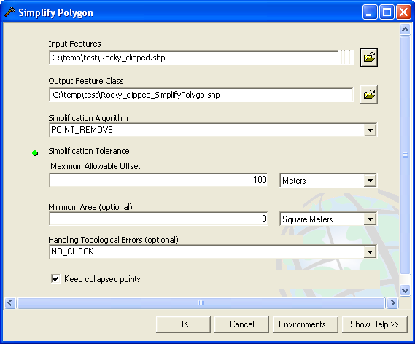
Generalization
ArcToolbox -> Data Management Tools -> Generalization -> …
Notes:
Need this to simply the wildlife refuges for the entire United States to make it render faster (i.e. I did not need the very high resolution data they provided).

Slide 11
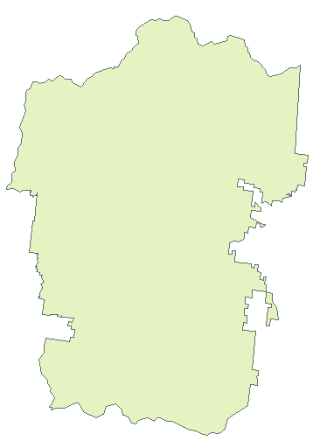
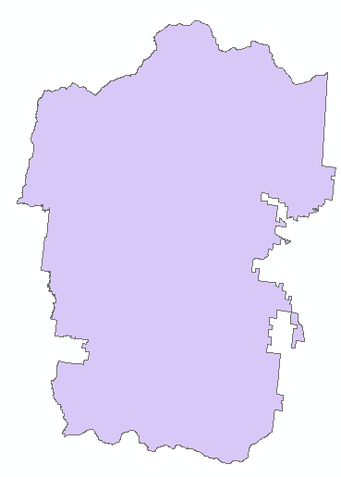
Generalization (100 meters)
Original
Generalized to 100 meters

Slide 12
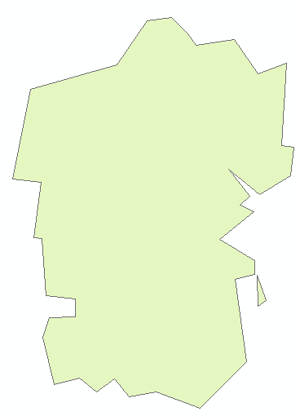
Generalization (1000 meters)
Original
Generalized to 1000 meters

Slide 13
Vector Processing
Perform math on attributes using “Field Calculator”
Query attributes to select desired features
Right click on layer -> Selection -> Create Layer from Selected Features
  New Shapefile and Layer
Perform spatial analysis
Repeat

Slide 14
Problem 1
Find the area of potential overspray from a farm into a conservation easement if:
  You have a shapefile for the farm and the conservation easement
  The overspray can be up to 50 meters

Slide 15
Problem 2
Find the harvestable area of a forest given:
  Stream shapefile
  Forest shapefile
  You cannot harvest within 15 meters of a stream

Slide 16
Problem 3
What is the total length of roads that are within 20 meters of a stream given:
  Stream shapefile
  Road shapefile

