Slide 1
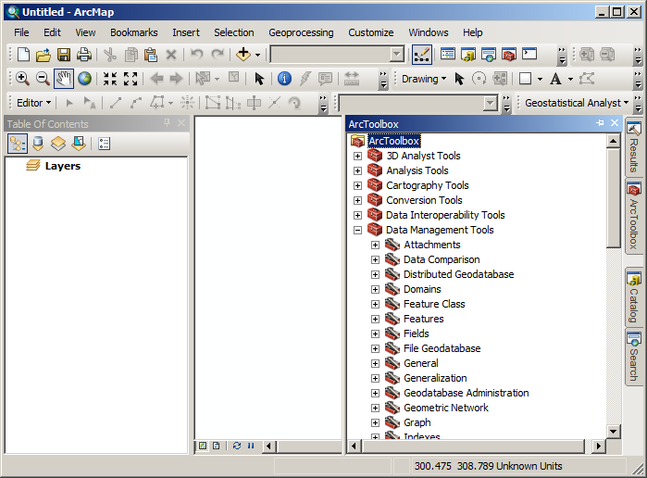
Toolbox Icon
Pin the Toolbox
Toolbox Tab

Slide 2
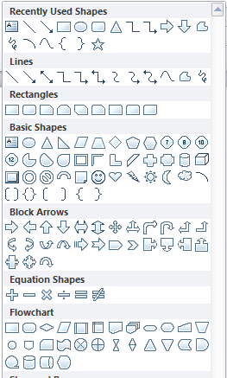

Slide 3
Start
Start and End
?
Decision
Process
Something that changes data
Data set
Typically a layer in ArcMap
Shows the “flow” of processing

Slide 4
Start
Load File
Data set
Visual Inspection
Has clouds over HSU
Yes
Process
No
Stop

Slide 5
Start
Humboldt Streams
Humboldt Ownership
Clip
Select National Forests
National Forest Streams
Create Layer
From selection
Join
National Forests
National Forest Streams Joined
Compute Length
Dissolve
National Forest Streams Dissolved
National Forest Streams Dissolved
Stop

Slide 6
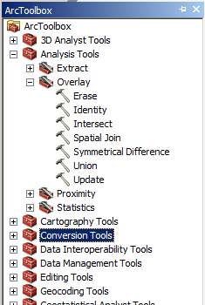
Erase
Intersect

