Slide 1
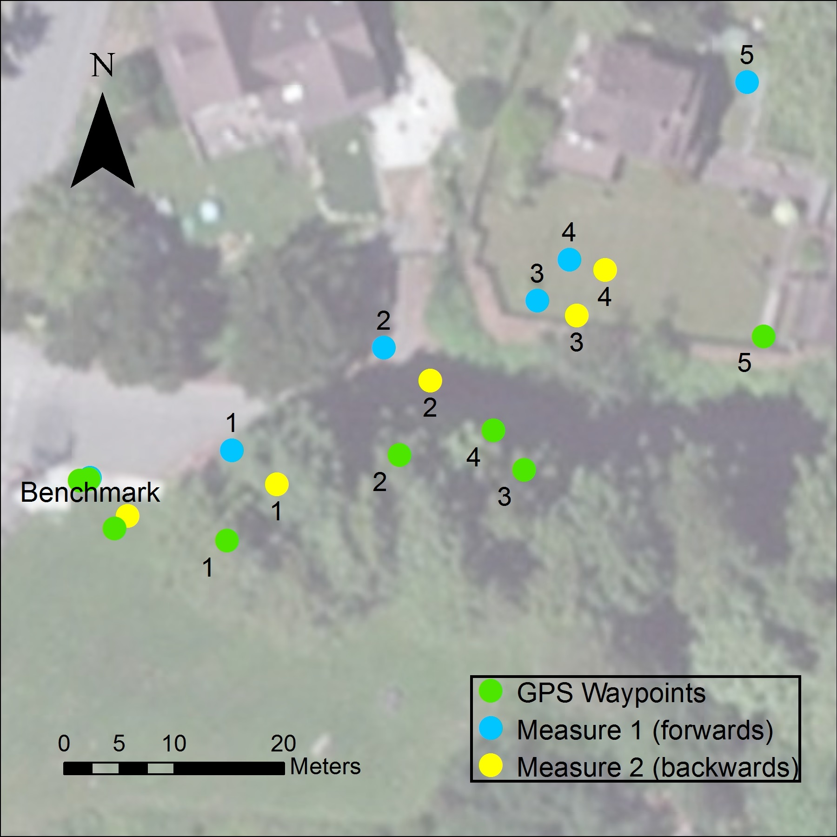
Figure 2. A map of the coordinates of GPS measurements and those calculated from two measures of horizontal distance and azimuth. (Millen McCord)

Slide 2
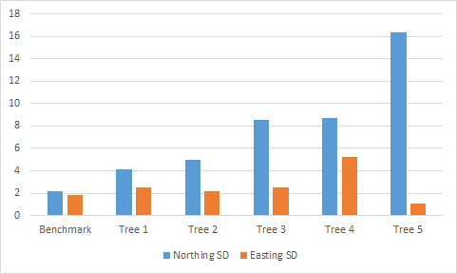
Figure 3. A graph showing the trend of increasing Northing standard deviation (SD) with distance from the benchmark point. There is no apparent trend with Easting SD. (Millen McCord)

