Slide 1
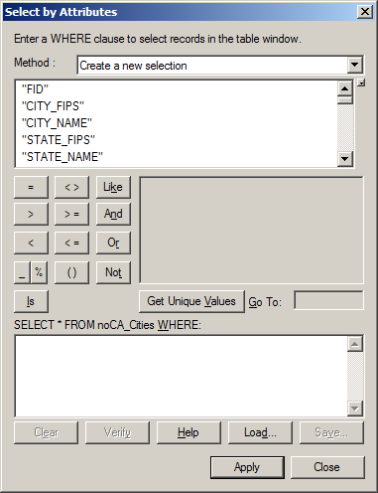
Action to take
Attribute
Columns or Fields
Operators
List of Unique Values for a Field
SQL “Where” clause or “Filter”

Slide 2
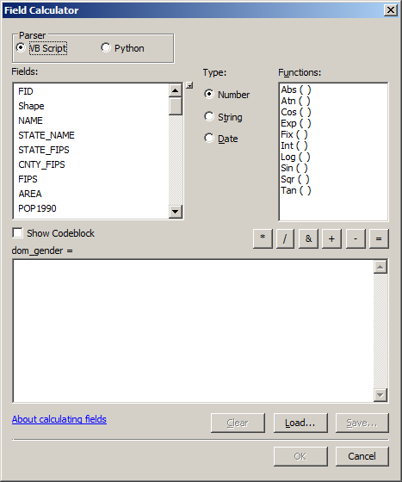
Type of functions
Fields to include
in the calculation
Available functions
Operators
Calculation about to be performed

Slide 3
