Slide 1
Remotely Sensed Data
GSP 510
Fall 2023
Dr. Jim Graham
Materials from Sara Hanna

Slide 2
Remotely Sensed Data
Remotely Sensed data is:
Acquired remotely from the observer
This makes it different from field surveys
Acquired by:
Satellites
Airplanes
UAVs/UAS/Drones
Automated Stations?

Slide 3
Active vs. Passive
“Sensors” can be active or passive
Active sensors send out a signal and measure the returned signal:
LiDAR
Radar
Passive sensors measure energy emitted by another source, usually the sun
Most of the data we use (except DEMs) are from passive sensors so we’ll be talking about them from now on
For more information, see GSP 216

Slide 4
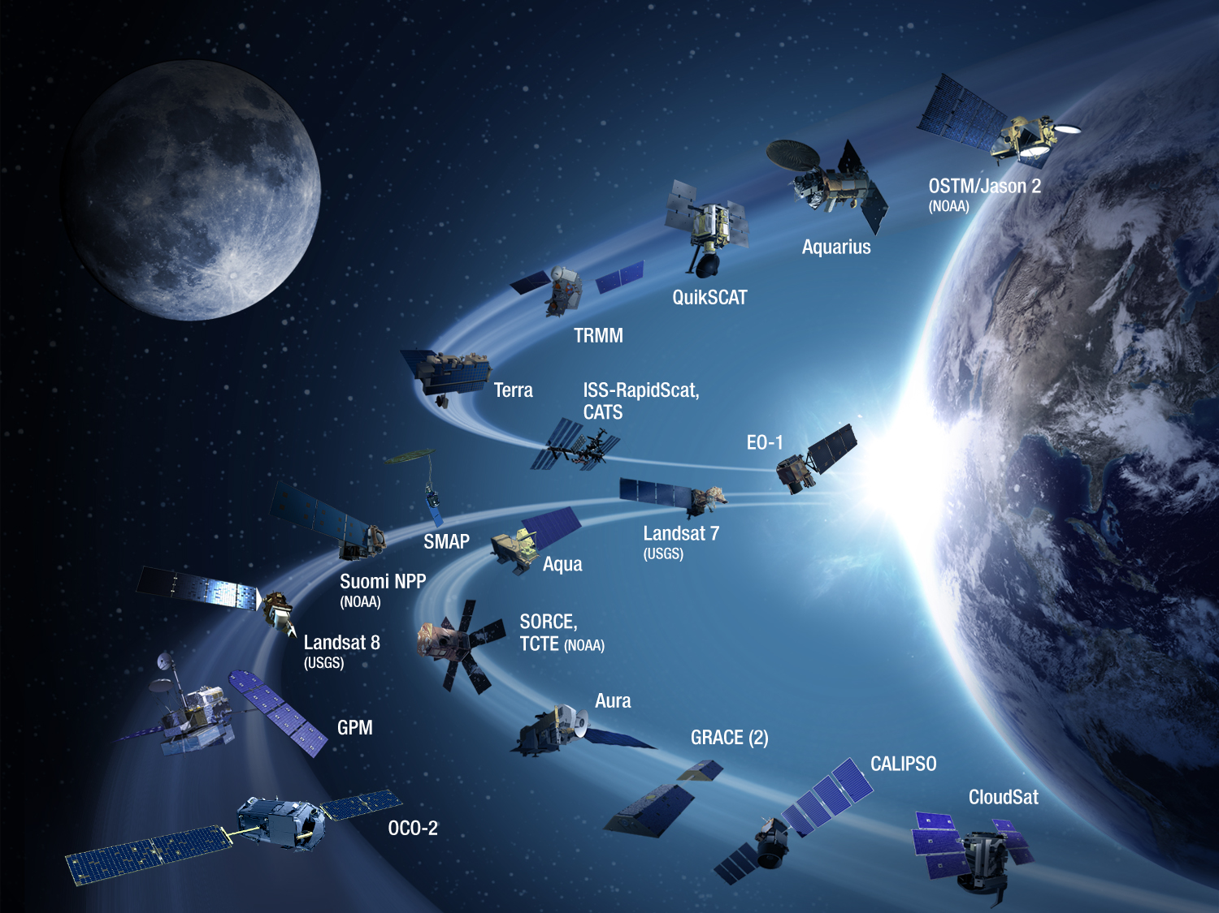
Earth Observing Satellites

Slide 5
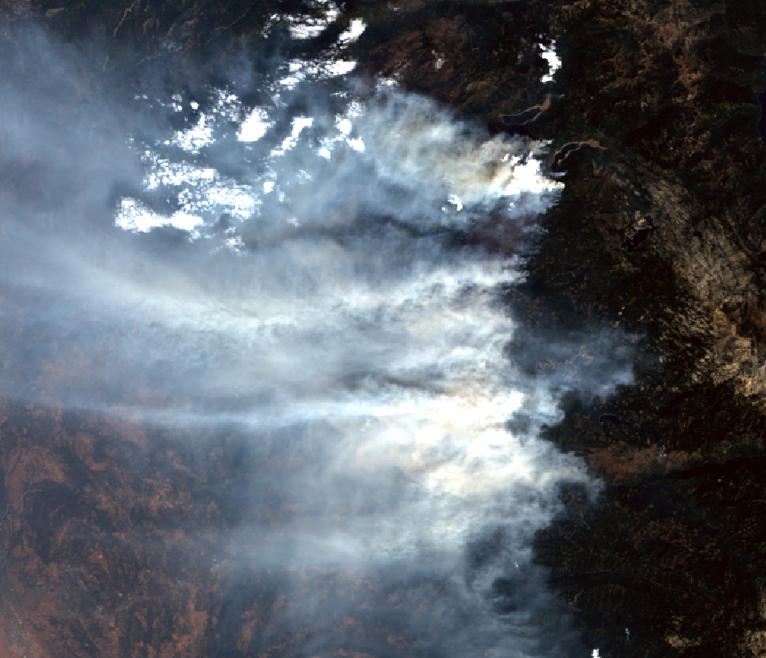
Landsat 8 – King Fire
True Color
Notes:
The King Fire was a wildfire that scorched over 97,000 acres of land in El Dorado County, California in the fall of 2014

Slide 6
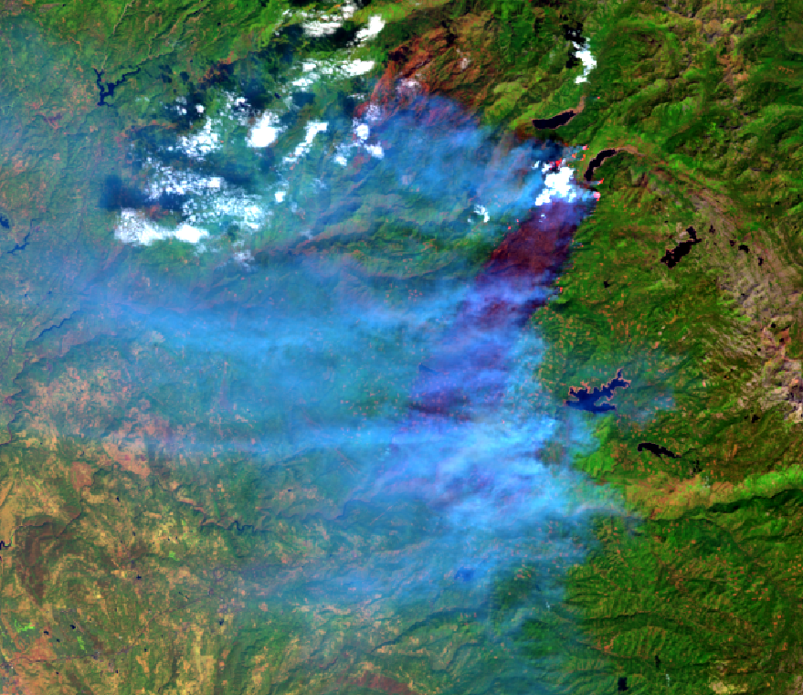
Landsat 8 - King Fire
False Color (Red – Shortwave Infrared, Green – NIR, Blue – Visible)

Slide 7
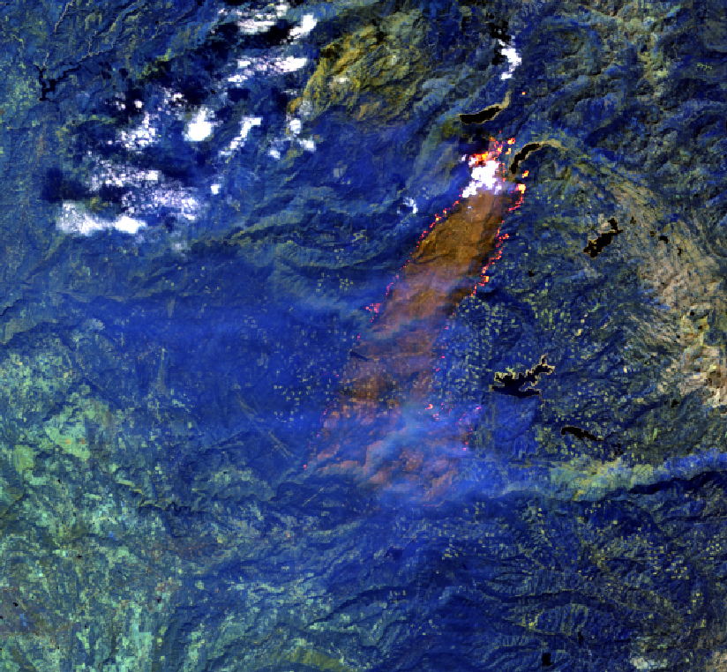
Landsat 8 - King Fire
False Color (Red – Shortwave Infrared, Green – Shortwave Infrared, Blue – NIR)

Slide 8
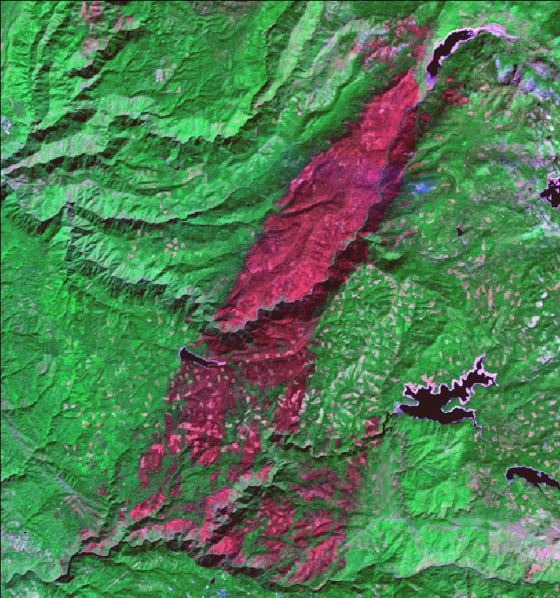
Landsat 8 – King Fire October 5, 2014

Slide 9
Landsat Timeline

Slide 10
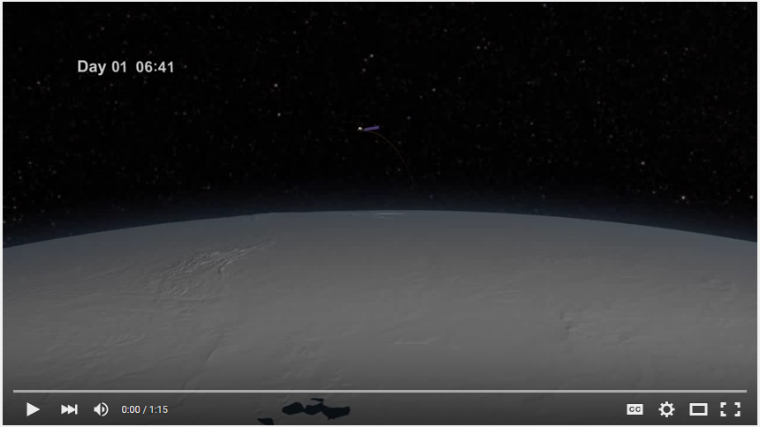
Landsat Orbit
http://www.youtube.com/watch?v=P-lbujsVa2M

Slide 11
Landsat
The Landsat satellites have carried six different sensor types
Return Beam Vidicon (RBV)
Multispectral Scanner (MSS)
Thematic Mapper (TM)
Enhanced Thematic Mapper (ETM)
Enhanced Thematic Mapper Plus (ETM+)
Operational Land Imager (OLI) and Thermal Infrared Sensor (TIRS)

Slide 12
Enhanced Thematic Mapper Plus (ETM+)
Enhanced Thematic Mapper Plus (ETM+) | Landsat 7 | Wavelength (micrometers) | Resolution (meters)
 | Band 1 | 0.45-0.52 | 30
 | Band 2 | 0.52-0.60 | 30
 | Band 3 | 0.63-0.69 | 30
 | Band 4 | 0.77-0.90 | 30
 | Band 5 | 1.55-1.75 | 30
 | Band 6 | 10.40-12.50 | 60
 | Band 7 | 2.09-2.35 | 30
 | Band 8 | .52-.90 | 15

Slide 13
Where to obtain data?
USGS EarthExplorer
http://earthexplorer.usgs.gov/
USGS Global Visualization Viewer - GLOVIS
http://glovis.usgs.gov/
USDA Geospatial Data Gateway
http://datagateway.nrcs.usda.gov/
Open Topography
https://opentopography.org/
Google Earth Engine
https://earthengine.google.com/
Lots of other places

Slide 14
What data products are available?
Landsat Archive
MODIS
Aerial photos
Historical
NHAP/NAAP/NAIP
Digital Elevation Models
Canopy Height from LiDAR
Climate Data
Watershed
Land Use/ Land Cover
Soils

Slide 15
File Sizes
MODIS Image -11,127,225 pixels (7 bands, 500m resolution)
Landsat Panchromatic - 234,404,221 pixels (1 band,15 m resolution)
Landsat Multispectral - 58,532,901 pixels (7 bands, 30m resolution)
NAIP Image - 261,532,200 pixels (4 bands, 1 m resolution)

Slide 16
What format ?
Most data is downloaded in a compressed format
Large file sizes
Various file formats
GeoTIFF common

Slide 17
Commercial
SPOT – 1986-2014 (1.5 – 20m)
IKONOS – 1999 (1 -4 m)
Quickbird – 2001 (0.60 - 2.4 m)
World-View-2 – 2009 (0.46 – 1.84m)
WorldView-3 – 2014 (0.31 – 3.7 m)
Disaster Monitoring Constellation (DMC) 2002-Present
Five satellites, 30-40 m in 3-4 bands
Others…

Slide 18
Electromagnetic Radiation
Most remotely sensed data is derived from Electromagnetic Radiation (EMR). This includes:
Visible light
Infrared light (heat)
X-Rays
Radar
Etc.
To use RS data we need to review some information on EM

