Slide 1
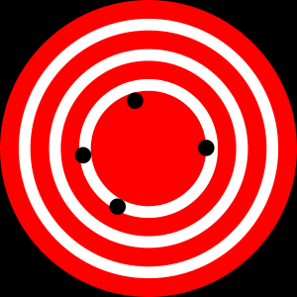
Accuracy and Precision
High Accuracy
Low Precision
Low Accuracy
High Precision
http://en.wikipedia.org/wiki/Accuracy_and_precision
Notes:
These are the formal terms, accuracy is often used to refer to uncertainty in general

Slide 2
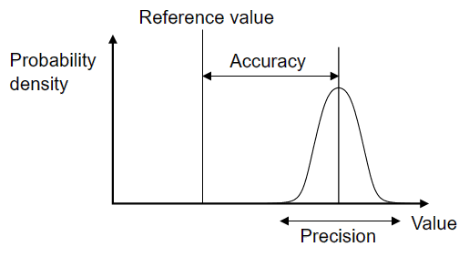
Accuracy and Precision
Accuracy = distance from truth
Precision = repeatability
Wikipedia

Slide 3
Precision
Estimate:
Standard Deviation: Precision
Standard Error: Precision
Confidence Interval: Precision
Min/Max: Precision
Manage:
Significant Digits
Data types: Doubles, Long Integers
Report

Slide 4
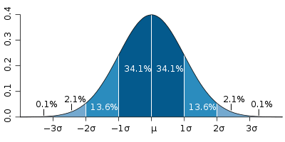
Standard Deviation (Precision)
Each band represents one standard deviation
Source: Wikipedia
Notes:
4

Slide 5
RMSE From Higher Accuracy

