Slide 1
By: Nathan Alexander, 2015

Slide 2
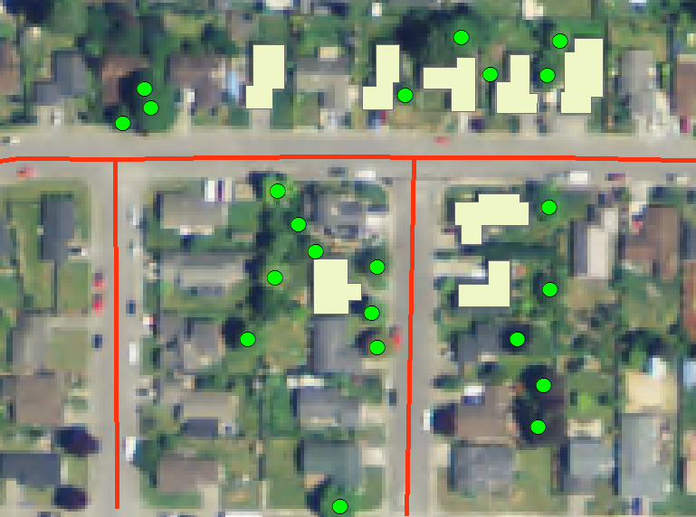
By: Richela Maeda

Slide 3
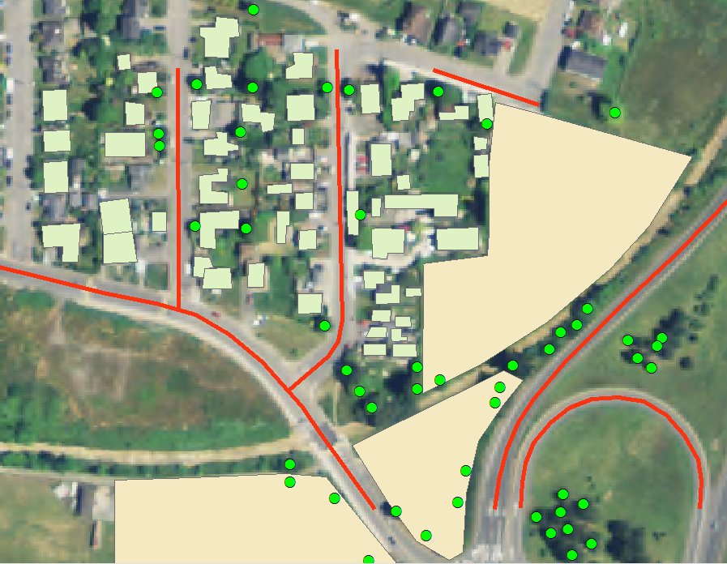
By: Michelle Haskins

