Slide 1
Sea Level Rise Results
 | Min | Max | Mean | StdDev
City | 1827 | 2010 | 1984 | 63
Agriculture | 399 | 13267 | 11646 | 4544
Residential | 826 | 847 | 837 | 8
Commercial | 54 | 65 | 57 | 4
Industrial | 566 | 592 | 589 | 9
Recreational | 2 | 2444 | 2027 | 821
Tribal | 1 | 2 | 1 | 0
Public | 535 | 558 | 552 | 8
Other | 50 | 2468 | 423 | 827

Slide 2
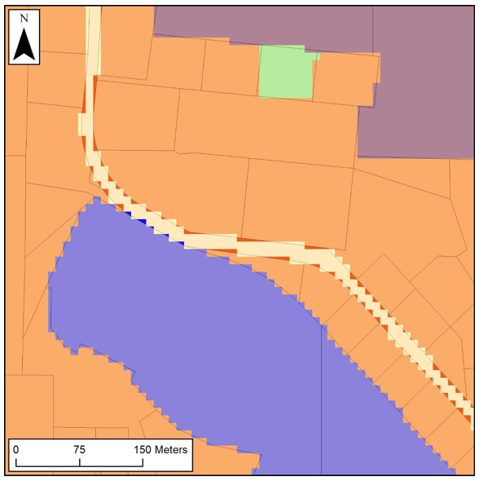
Notes:
Josh Martinez

Slide 3
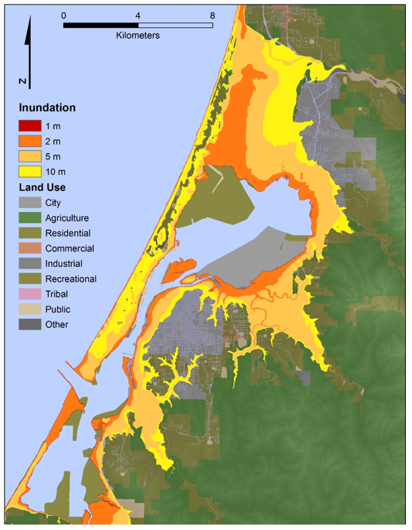
Notes:
Amon

Slide 4
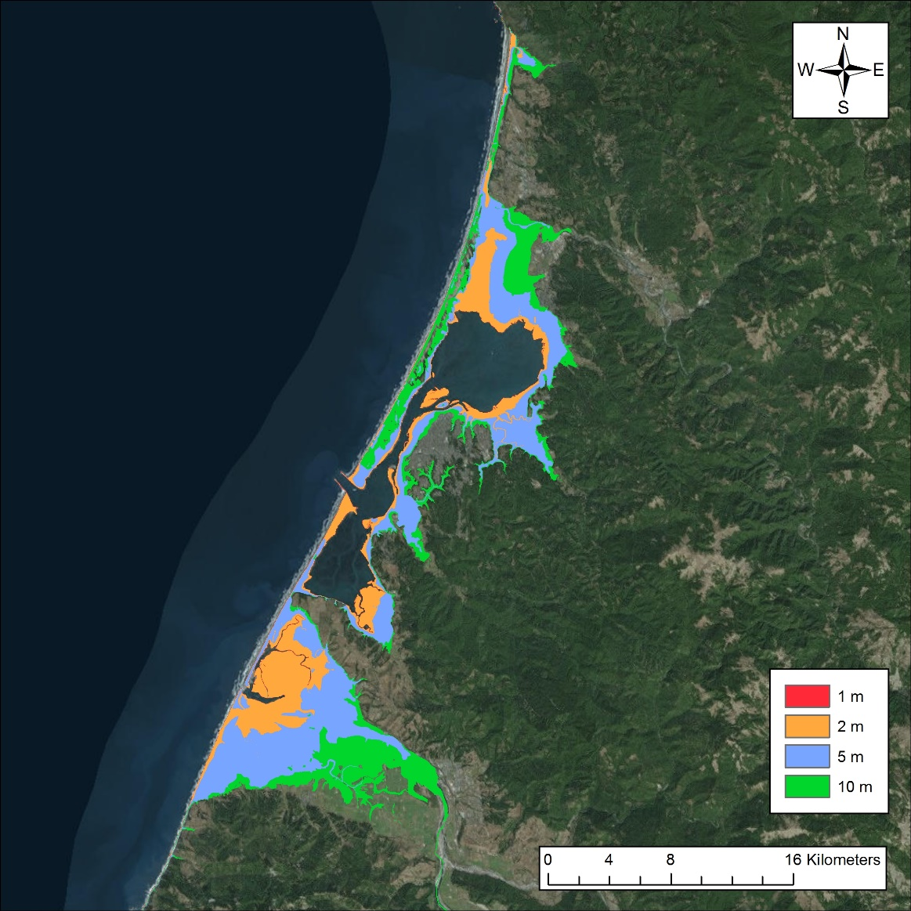
Notes:
Emily

Slide 5
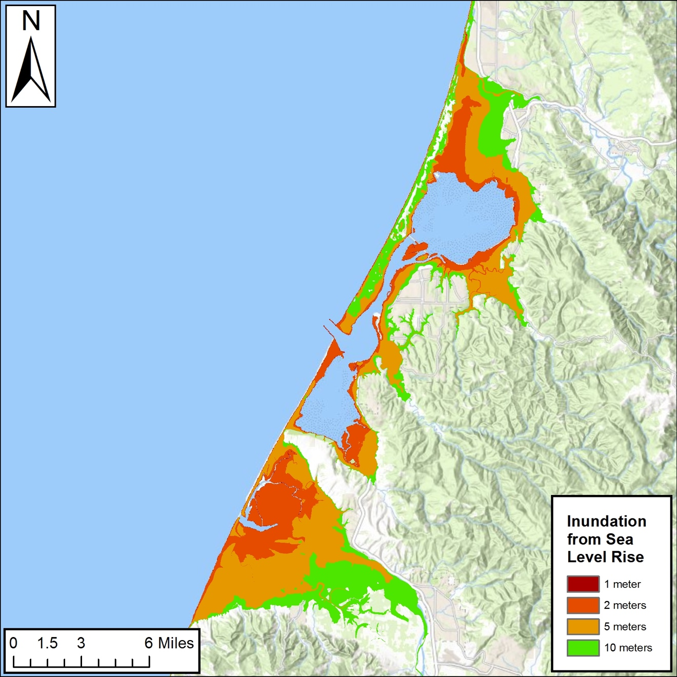
Notes:
Robert

Slide 6
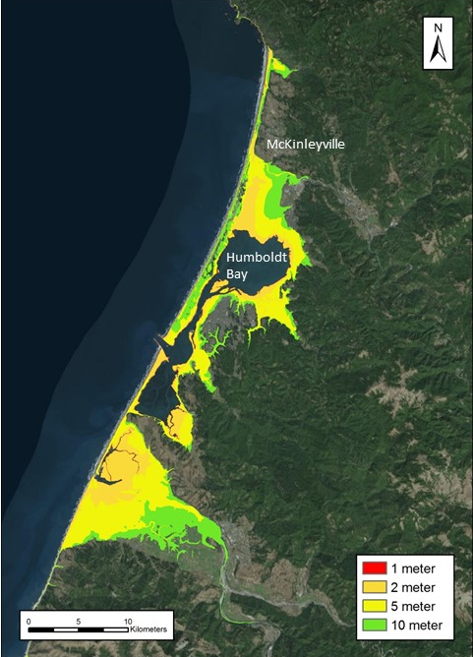

Slide 7
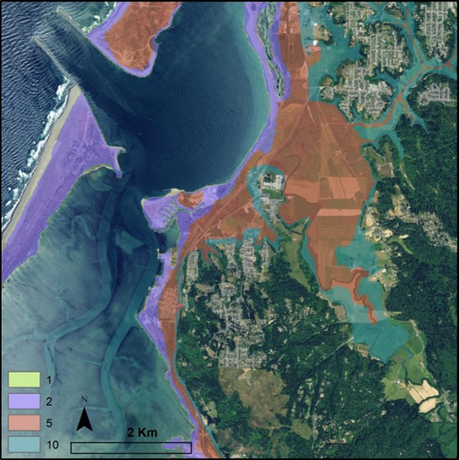

Slide 8
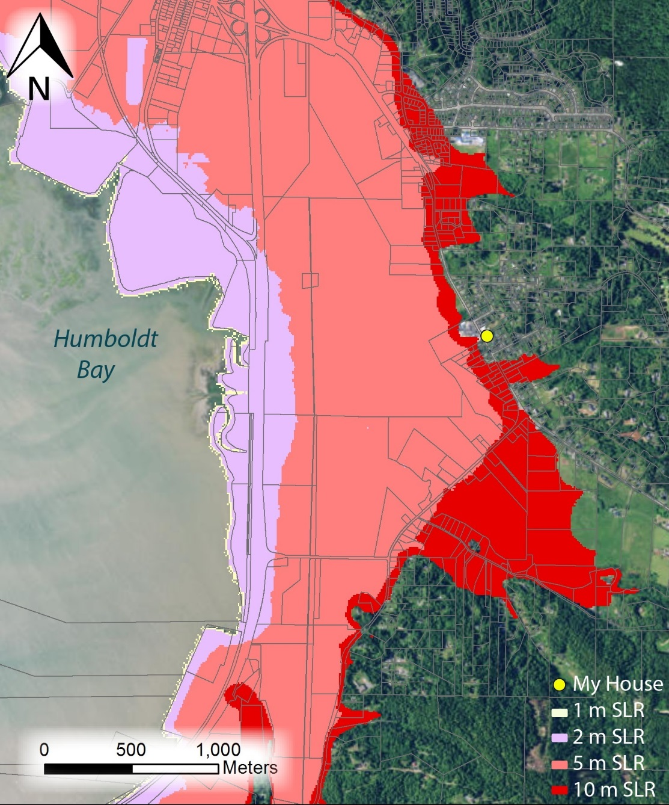
Notes:
Tina

