Slide 1
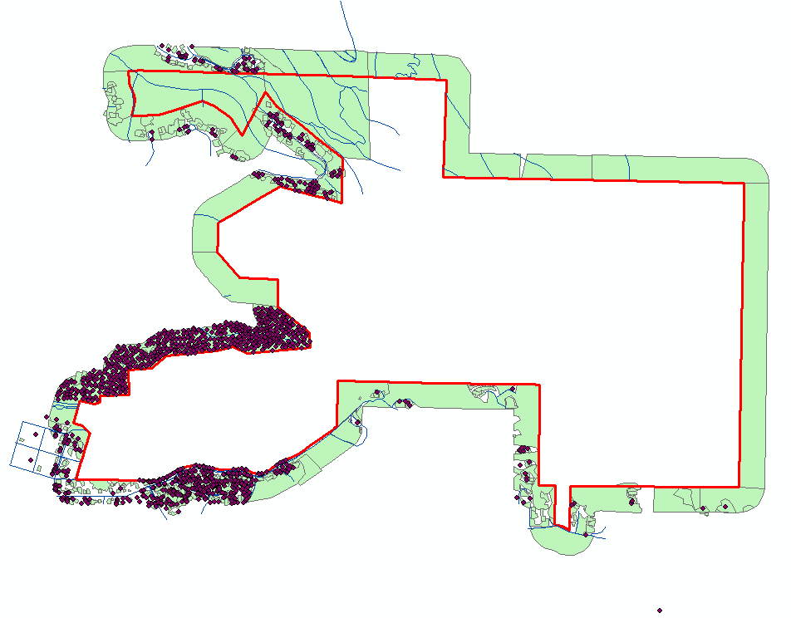
Digitizing Ground Arcata Forest, GSP 510 Class, 2018

