Slide 1
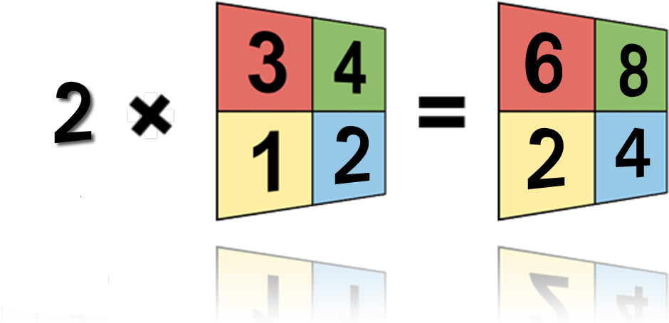
Raster Math
Dana Tomlin and Joseph Berry (1970’s)
A method of treating individual raster layers as members of algebraic expressions.
2 * LayerA

Slide 2
Raster Analysis
Map Algebra Examples:
Fire Hazard:
[Fuel Density Hazard] + [Slope Hazard] + [Veg Type Hazard]
Probability of encountering the cascade treefrog (Litoria pearsoniana) within the forests of eastern Australia:
1 / (1 + exp(10.48 – 2.204 * log₁₀(RAINFALL) – 2.037 * PALMS))
RAINFALL= the annual volume of rain falling in the watershed above the stream
PALMS = 1 if palms are present at the site and 0 otherwise.

Slide 3
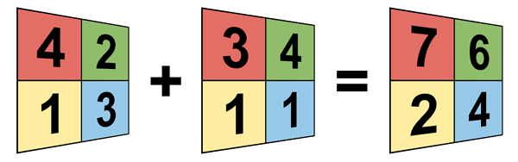
Raster Math
LayerA + LayerB
Arithmetic Operators (+, -, *, /)
Mathematical Functions (Sqr, Sqrt, Log, Abs, exp, int, etc.)
Comparison Operators (>, >=, =, <>, <, <=)
Boolean Operators (AND, OR, NOT, XOR)

Slide 4
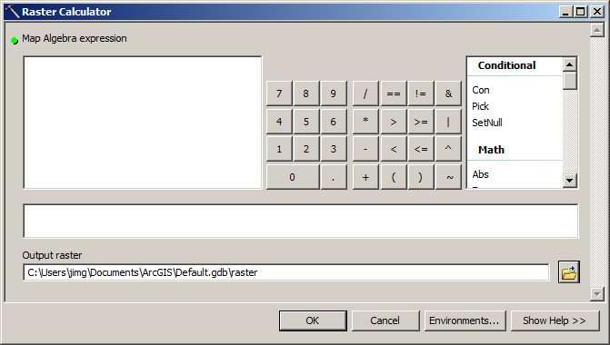
Raster Calculator
Toolbox → Spatial Analysis Tools → Map Algebra → Raster Calculator

Slide 5
Test Yourself
3 | 4
2 | 3
0 | 1
2 | 9
-
=

Slide 6
Analysis Environment
Spatial Reference (Coordinate System)
  Make them the same
Extent
  Area of interest
  All rasters should overlap
Cell Size
  Largest of all rasters or larger

Slide 7
Raster Math
Raster Math ≠ Vector or Linear Algebra
1
+
12
=
13
1 | 2
2 | 3
12 | 9
13 | 10
13 | 11
15 | 13
+
=

Slide 8
Common Functions
Local:
  Arithmatic: +,-,/, *,
    MOD (Modulo): returns the remainder
  Boolean:
    OR: If either input is true, output is true
    AND: If both inputs are true, output is true
  CON (Conditional)

Slide 9
Mathematical Functions
Abs (absolute): flips negatives to positive
Ceil (ceiling): float to integer next highest integer value (i.e. 1.1 -> 2)
Floor: float to integer giving next lowest integer value (i.e. 1.1 -> 1)
Int (integer): truncates float to integer

Slide 10
Comparisons
<> (Not Equals)
== (Equals)
< (Less than)
<= (Less than or equal to)
> (Greater than)
>= (Greater than or equal to)

Slide 11
Raster Math: Comparisons
1
>
2
=
0
1 | 2
2 | 3
2 | 2
3 | 2
0 | 0
0 | 1
>
=

Slide 12
Raster Math: Boolean AND
0
AND
1
=
0
0 | 0
1 | 1
0 | 1
0 | 1
0 | 0
0 | 1
AND
=
“AND” works but the calculator will insert “&”

Slide 13
Raster Math: Boolean OR
0
OR
1
=
1
0 | 0
0 | 1
1 | 1
0 | 1
1 | 1
0 | 1
OR
=
“OR” works but the calculator will insert “!”

