Slide 1
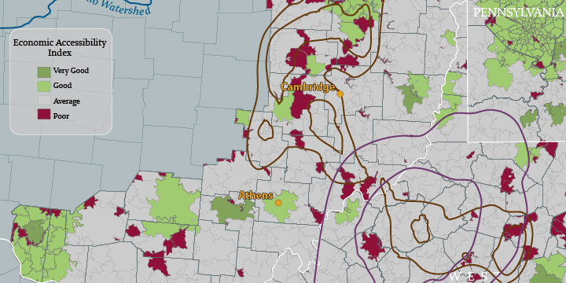
Presenting GIS Data
Makin’ Maps and other groovy stuff
by Amy Rock
with a few edits by Jim Graham

Slide 2
Notes on Maps in Reports
This presentation was originally for maps that stand alone. Maps in reports (both on paper and the web) typically illustrate concepts described in text. Because of this, they are smaller and simpler. Also, each map typically illustrates one concept or “theme”. They do not have:
- A title, this is in the caption
- Lots of text, this should be in the caption and/or prose
- Inset maps, instead, do two maps
- Scale bars and north arrows are only added if needed

Slide 3
Flow of information
Create
Analyze
Display
Manage
Create/Input
Manage/Maintain
Analyze
Display/Output
Display

Slide 4
What is the purpose of a map?
To communicate information
To attract/retain the viewer’s interest

Slide 5

GIS and Cartography
With today’s GIS technology, anyone can make some sort of map.
The goal is to make a map using proper cartographic principles

Slide 6
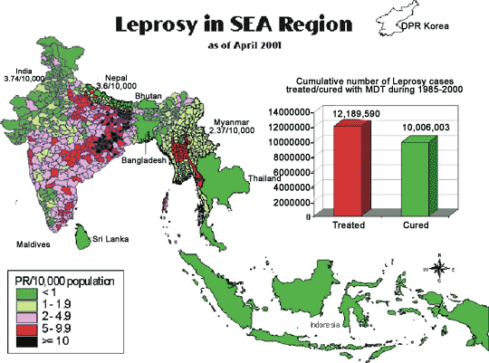
Cartography Gone Wrong

Slide 7
Cartographic Basics
Who?
  Who is the intended audience?
What?
  What information needs to be conveyed?
When?
  Is this a moment in time, or a long-term (longitudinal) evaluation?
Where?
  What is the geographic extent?
How?
  How can I best represent this information?

Slide 8
Seven Elements of Map Composition
Information commonly needed by the map reader
  Body of the map: must for all maps
  Scale: must for wall maps, only in report maps if needed
  Direction: must for wall maps, only in report maps if needed
  Title: wall maps only
  Legend: only if needed
  Neatline: as needed
  Credits (cartographer, date of production, projection used, and information about sources): Only in wall maps. For report-maps, include in the caption, prose and/or references as appropriate.
  Remember: The goal is effective communication. Leaving something out can hurt communication but so can including elements that clutter the map

Slide 9
Scale
Provides the scope of the map.
Tertiary information – should be relatively small.
On small scale maps, the scale is only accurate in certain areas.
Note: “Small scale” means distances appear small (i.e. large extent, e.g. 1” = 25 kilometers)
“Large scale” means distances appear large (i.e. small extent, e.g. 1”=1 meter).
Notes:
A case could be made to leave off the scale for maps of entire continents

Slide 10
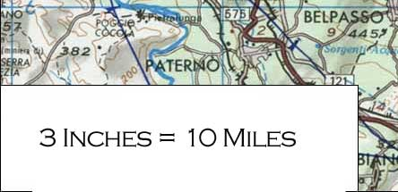
Types of Scale
Does not work on a computer screen!
Verbal Scale
This is useful to quickly convey to someone a sense of distance with which they are familiar.
Not good for maps which will be reproduced.

Slide 11
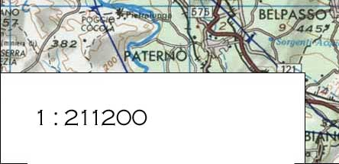
Types of Scale
Does not work on a computer screen!
Representative Fraction
Ratio of map units to real life ground units.
1:3168000 is the same as one inch equals fifty miles.

Slide 12
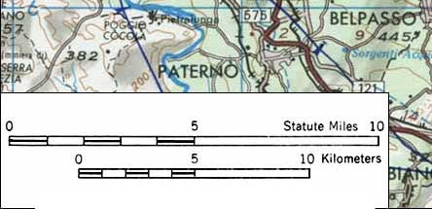
Types of Scale
Recommended by Jim
Bar Scale or Graphical Scale
This is the most practical type for GIS maps.
The graphical representation of distance changes size with the map features if reduced or enlarged.

Slide 13
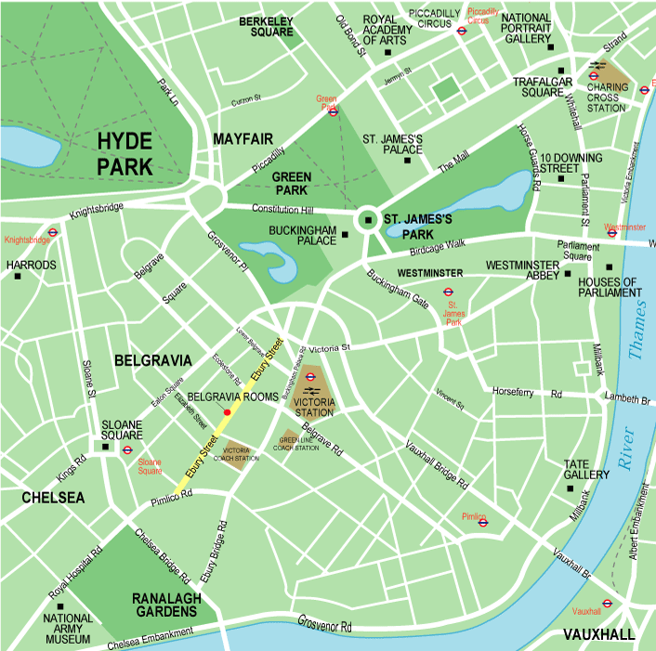
Large Scale Maps
(AKA small extent)
Highly detailed
Inclusion of many features
As finished size is reduced, details become blurred.
Examples
  Reference maps
  Navigational Charts
  USGS Quadrangles
  Terrain/relief maps

Slide 14
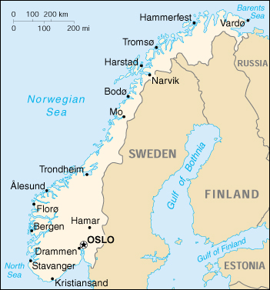
Small Scale Maps
(AKA Large Extent)
Less detailed, more abstract
Some features omitted
As finished size is enlarged, map becomes shapeless
Examples
  Thematic maps
  News maps
  Maps for less educated audiences

Slide 15
Direction
Provides a frame of reference for map content
This is tertiary information – should be small, subtle
For our purposes, north will usually be up.
Two principal methods: north arrow and graticule

Slide 16

North Arrow
include when an unusual orientation used (west up)
include when direction not obvious
typically used on large scale maps where direction applicable in more places
  use graticule on smaller scale maps
  North arrow is only absolutely accurate for one north-south line on the map (central meridian )
This is one of the areas where you can really express your creativity. There are endless possibilities for designs of north arrows.
Notes:
Central meridian is specific to the projection you are using

Slide 17
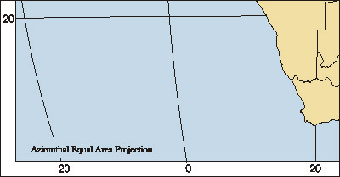
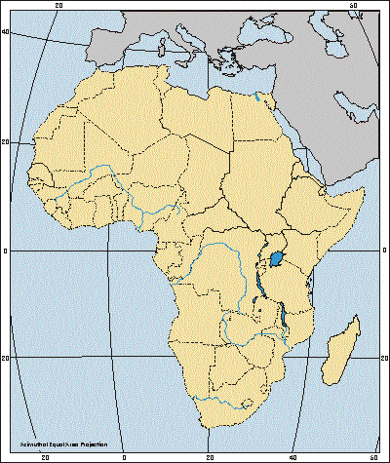
Graticule
Lines of latitude and longitude that geographers use to reference the earth. This is the preferred method for indicating direction on small scale maps. These must be labeled with the degree and the direction (N, S, E, or W), at or near where the lines intersect the edge of the map.

Slide 18
Body of the Map
As large as reasonably possible
This is the main focus – it needs to draw the eye first

Slide 19
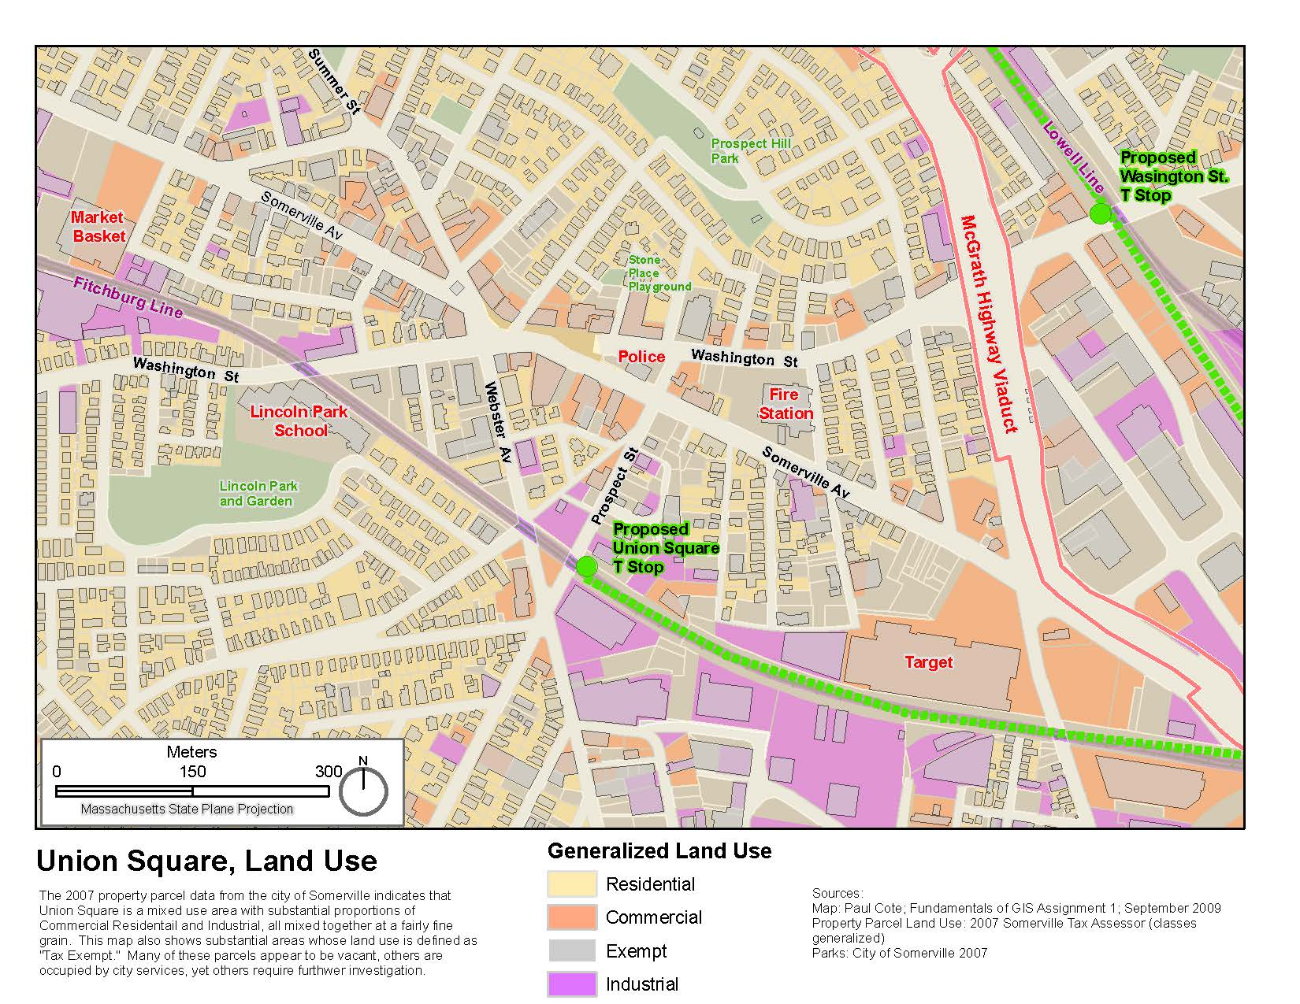

Slide 20
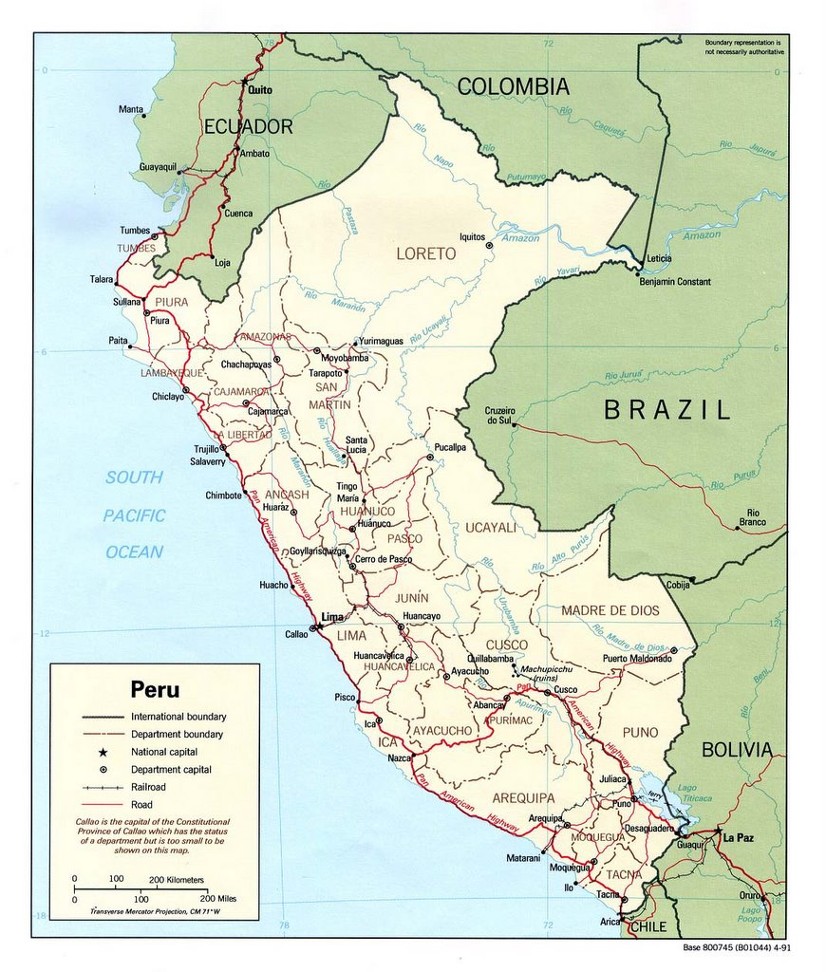
Big map
Small elements
All text must be readable and not “cut-off”

Slide 21
Title
Informative
Concise
Attention-getting
Can be omitted if part of larger content or included in the caption
Notes:
With the title, the mapmaker needs to get the attention of the audience. The title also needs to be informative, but brief and to the point. At times this is a daunting dichotomy. What we are trying to do is interest the reader enough to look at the rest of the map, while not bogging them down with a long, complicated title.

Slide 22
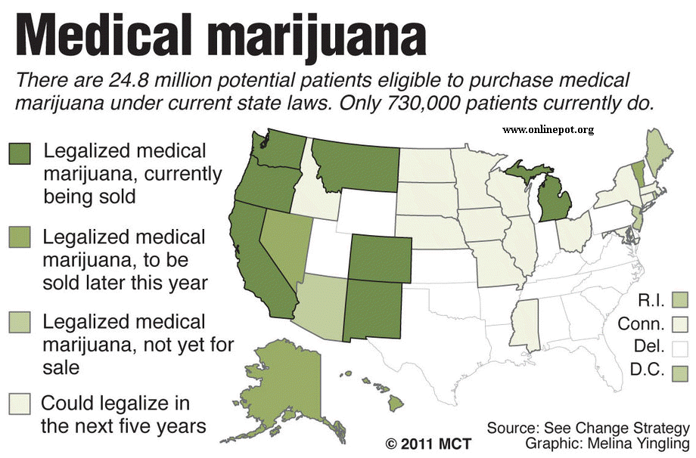

Slide 23
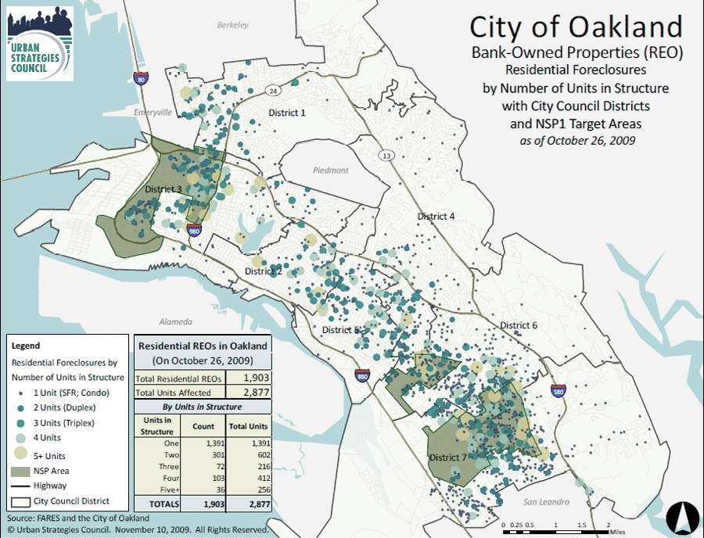

Slide 24
Legend
Description of all map items that need clarification
The symbol should always come before the description in the legend.
The symbol should always be the same size in the legend as it appears on the map.
You may need to redo-legends in PowerPoint

Slide 25
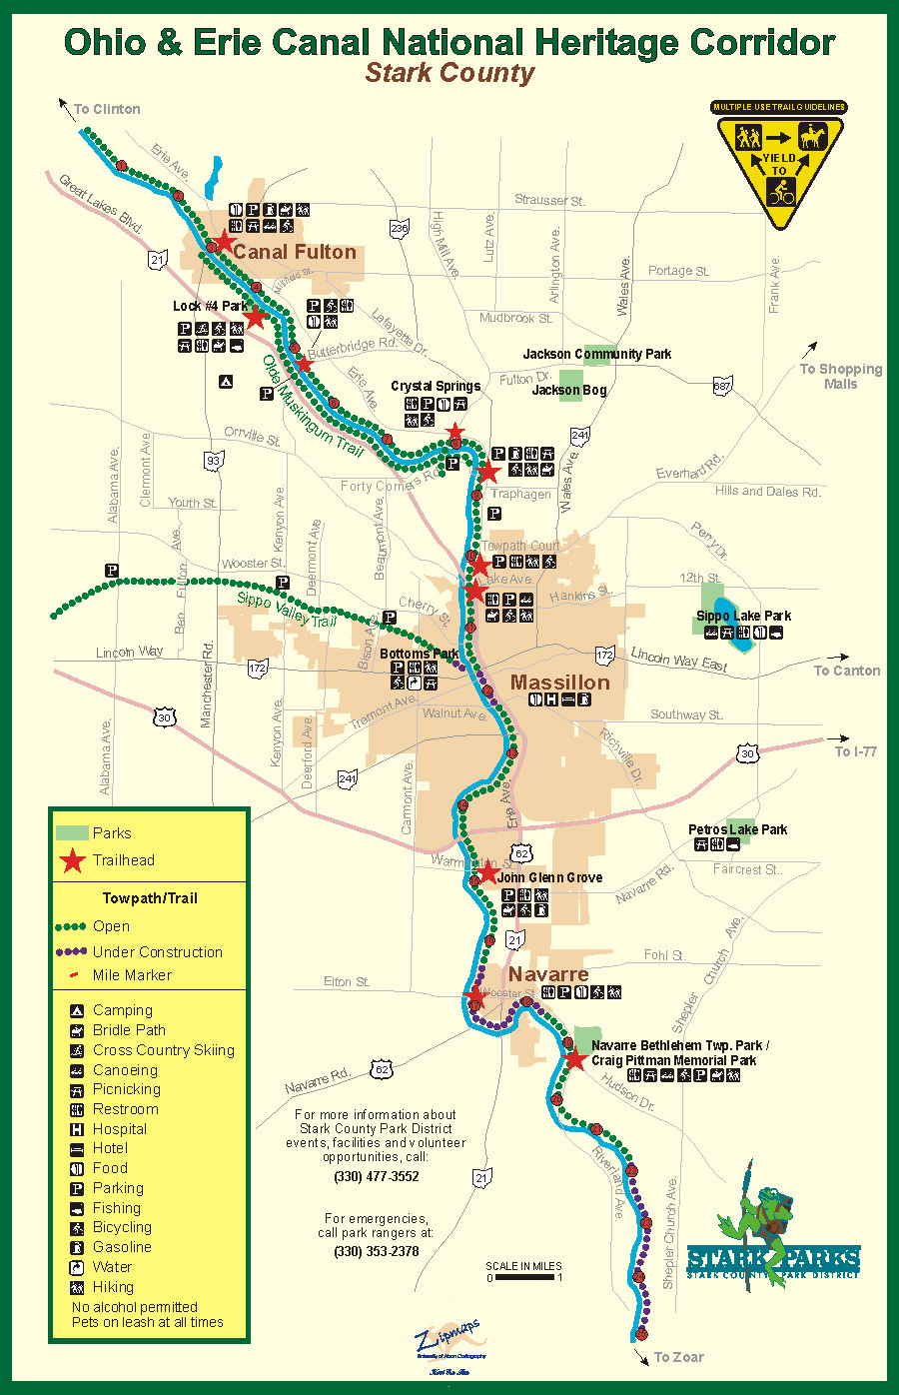
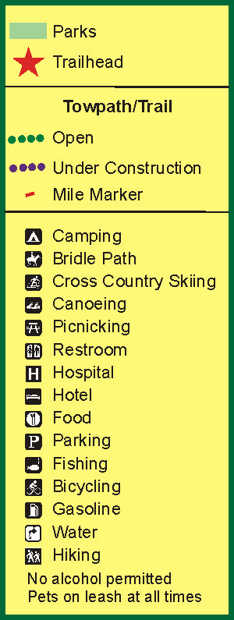
Notes:
Icons are always to the left of the text in the legend

Slide 26
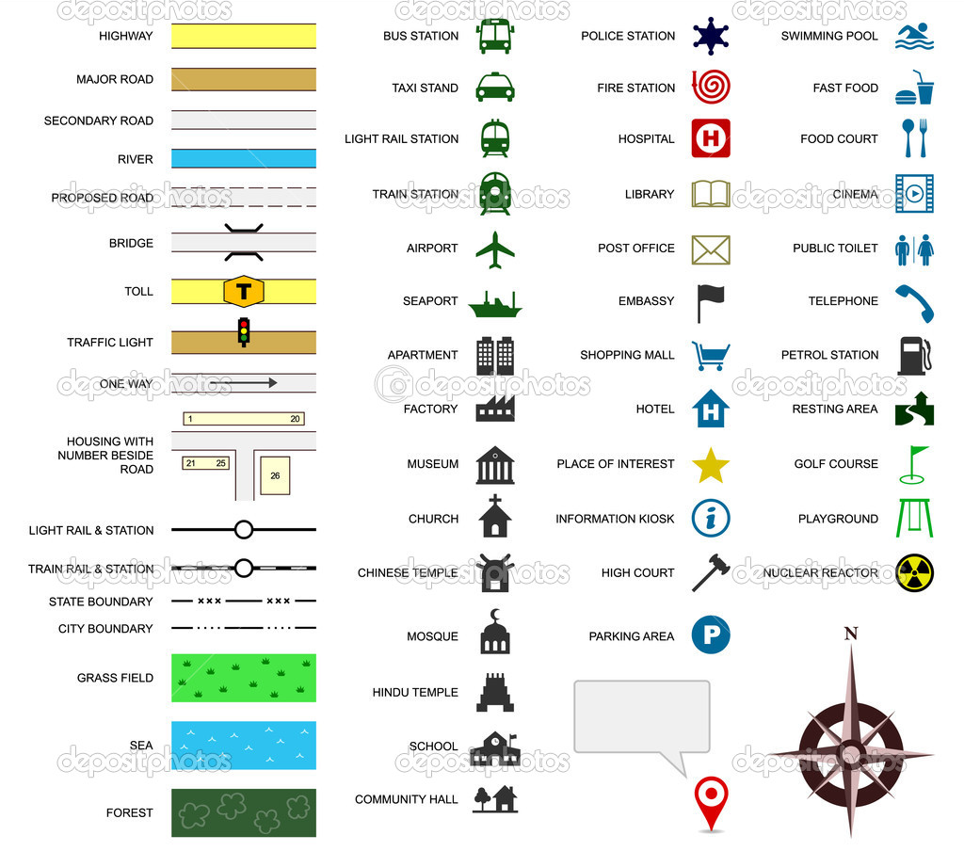
What happens when the description is first?

Slide 27
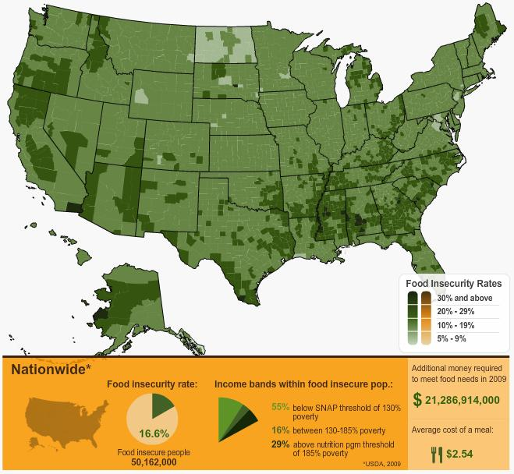

Slide 28
Legend – Cartographic Conventions
There are some conventions that should always be followed when making a map, that do not require identification in the legend.
  Water is generally blue, and all water bodies are labeled in italics.
  Other features should not be represented by the color blue, and water features are the ONLY things labeled in italics.
Never ever label the legend “Legend”

Slide 29
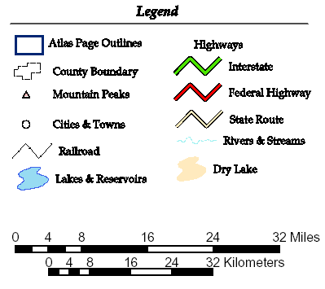
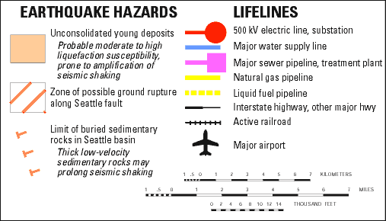
No.
Yes!

Slide 30
Border/Neatline
Used to separate map elements from each other, and also to delineate the edges of the map so that it doesn’t just fade into nothing.
This is not always necessary, and the thing that you should remember is that as long as you have justification for why you do something on your map, we will discuss it, and I will not just tell you that it is wrong.

Slide 31
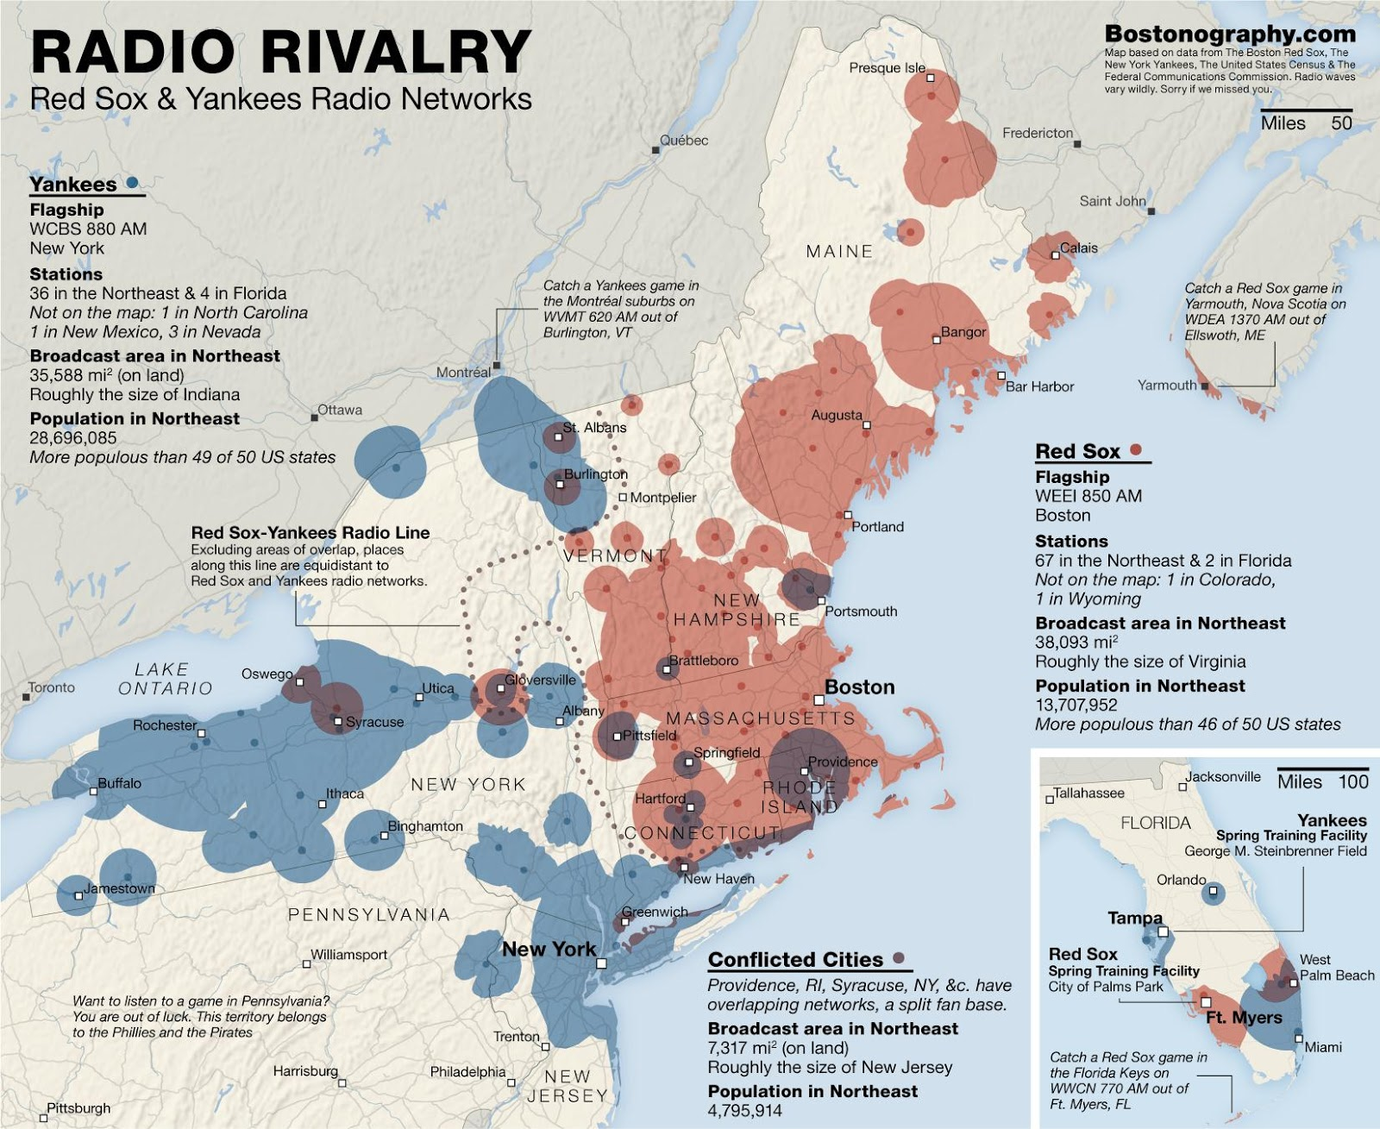

Slide 32
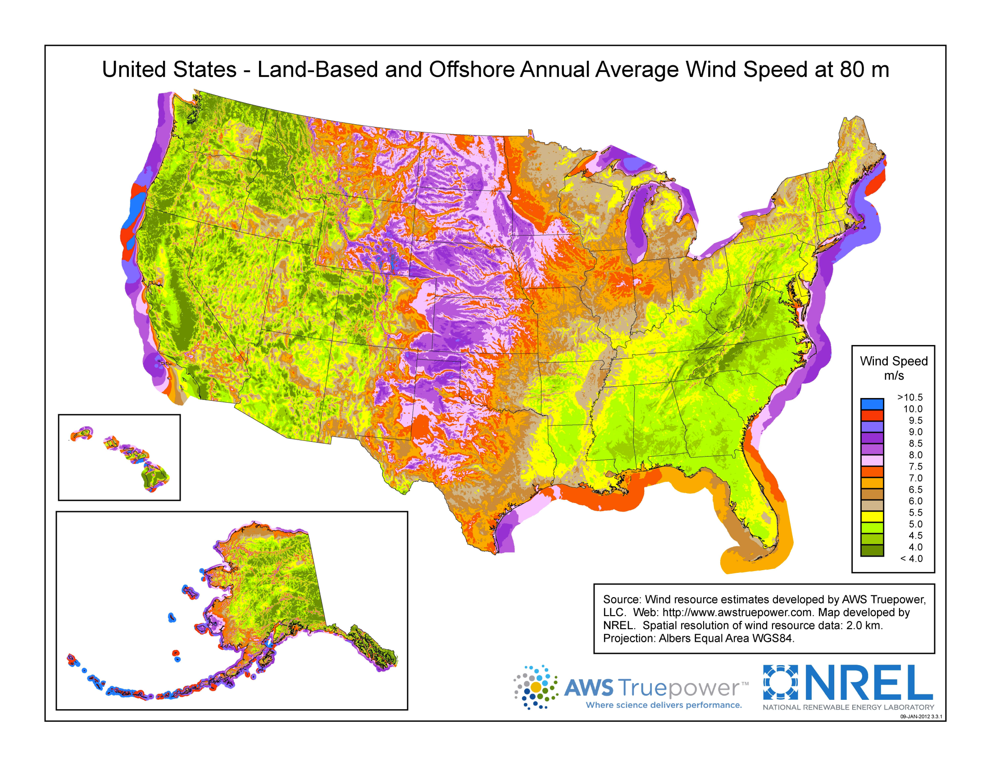

Slide 33
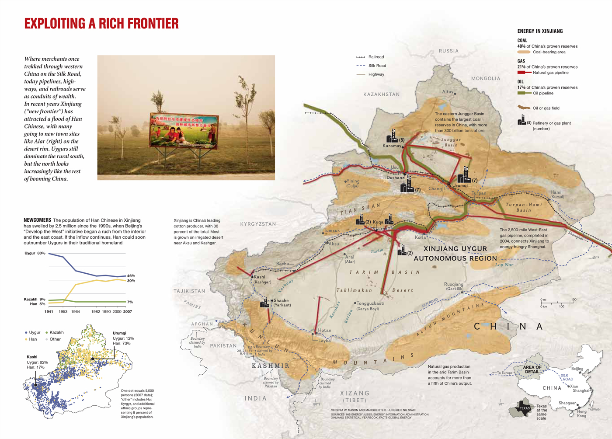
Source: National Geographic

Slide 34
Visual Balance
All map elements have weight and should be visually balanced around the visual center, which is just above the actual center.
  Be careful with blocks of dark colors, especially red
Balance does not always equal perfect symmetry
  Balance depends upon the location, size, color, shape and direction or orientation of map elements.
Control how your map reader moves through the information
  What should they see first?

Slide 35
Visual Center
Visual Center
5% of height
5% of height
Geometric Center
Landscape
Portrait

Slide 36
Natural eye movement across a page
Focus
Field
Fringe

Slide 37
Weight of Elements
More Weight
Less Weight
peripherally located
upper half
right side
isolated elements
large elements
red elements
regular shapes
compact shapes
vertically oriented
centrally located
lower half
left side
elements in groups
small elements
blue elements
irregular shapes
diffuse shapes
horizontally oriented

Slide 38
Visual Layout
Title Here
Title Here
Eye expects balance and alignment

Slide 39
Building Hierarchy
The Map
Title
(if present)
Scale
Direction
Legend
Credits
(name, date, source)

Slide 40
Two final cautions
Be careful with color
Be careful with patterns

Slide 41
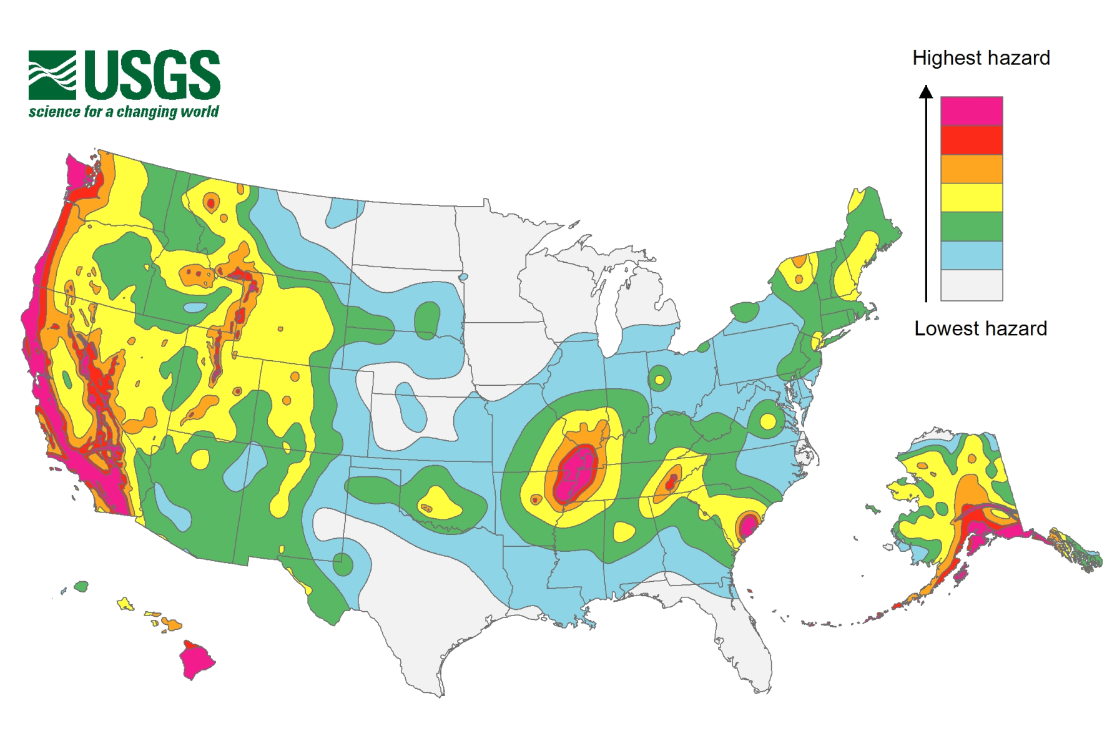
Figure 1. National Seismic Hazard Map for 2014 (USGS, http://earthquake.usgs.gov/hazards/products/conterminous/)

Slide 42
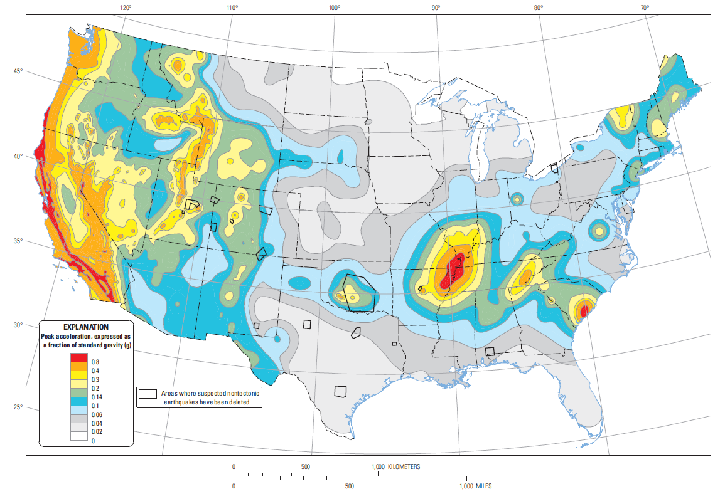
Figure 2. Two-percent probability of exceedance in 50 years map of peak ground acceleration (USGS, http://earthquake.usgs.gov/hazards/products/conterminous/2014/2014pga2pct.pdf)
Notes:
Link should be moved to a ciation

Slide 43
Figure 2. Two-percent probability of exceedance in 50 years map of peak ground acceleration (USGS, 2016)
Notes:
Link should be moved to a ciation

Slide 44
Other examPles
http://weather.unisys.com/usgs/

Slide 45
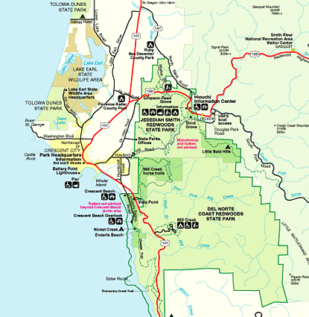

Slide 46
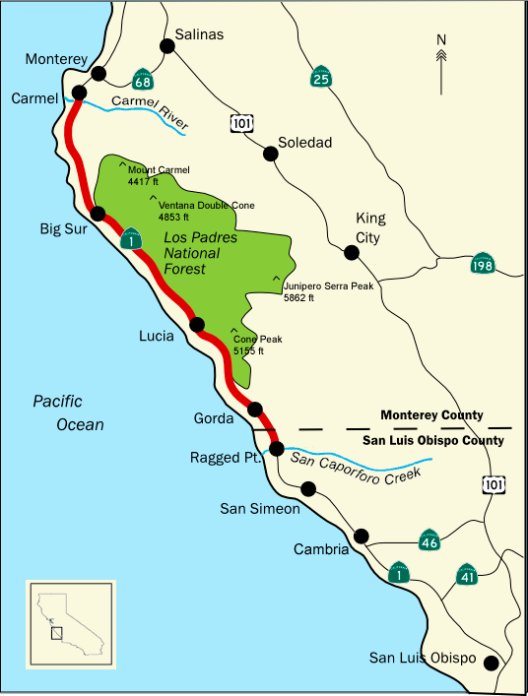

Slide 47
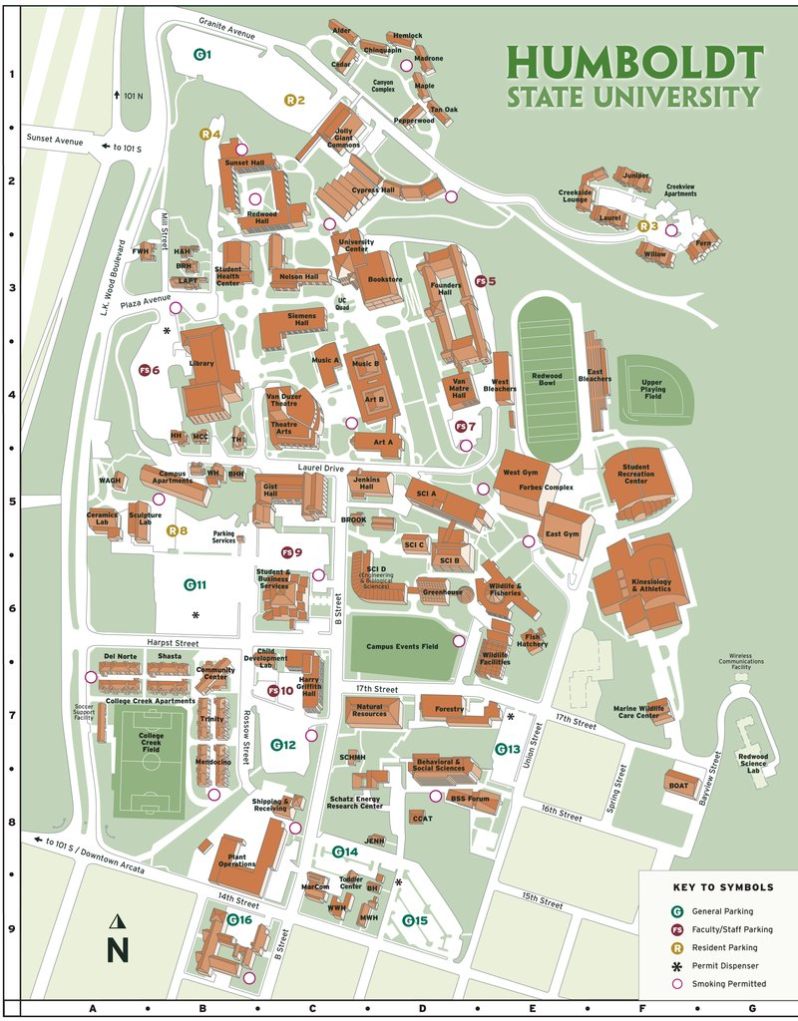

Slide 48
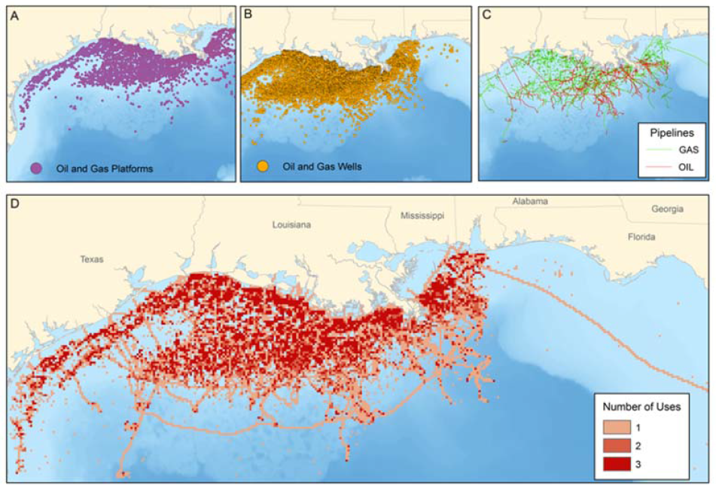
Figure 2: Location of present-day key oil and gas infrastructure in the Gulf of Mexico; Oil and Gas Platforms (A), Oil and Gas Wells (B), and Pipelines (C). Cumulative number of oil and gas ocean use activities per 4.77 x 4.77 km grid cell in the Gulf of Mexico (D). Number of uses per grid cell.
Notes:
2015 Bauer NETL-TRS-2-2015_CSIL_BroadImpacts.20150219

Slide 49
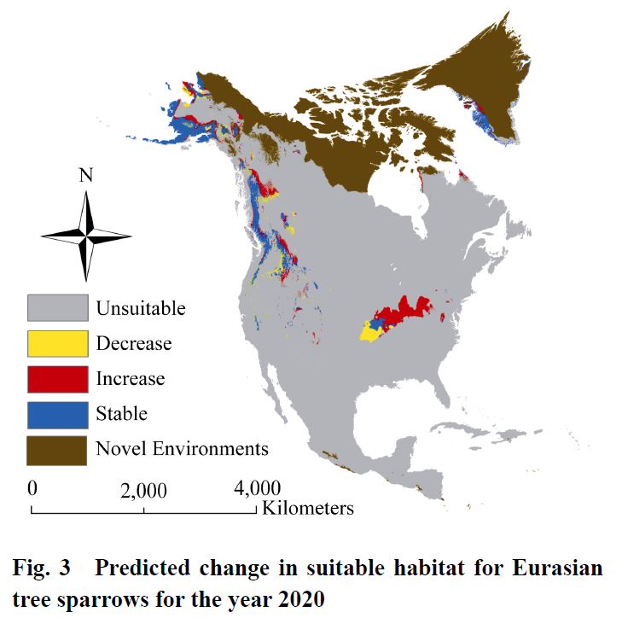
Notes:
How will climate change affect the potential distribution of
Eurasian tree sparrows Passer montanus in North America?
Jim GRAHAM1*, Catherine JARNEVICH2, Nick YOUNG1, Greg NEWMAN1,
Thomas STOHLGREN2

Slide 50
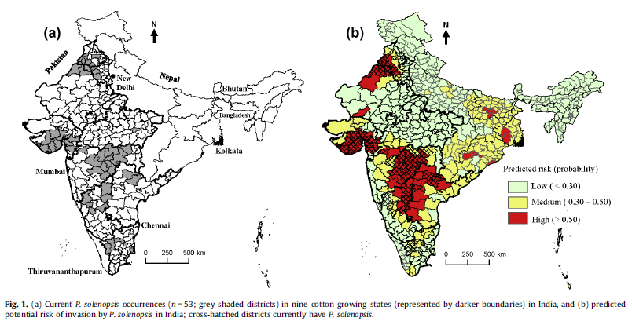
Notes:
Using district-level occurrences in MaxEnt for predicting the invasion
potential of an exotic insect pest in India
Sunil Kumar ⇑, Jim Graham 1, Amanda M. West, Paul H. Evangelista

Slide 51
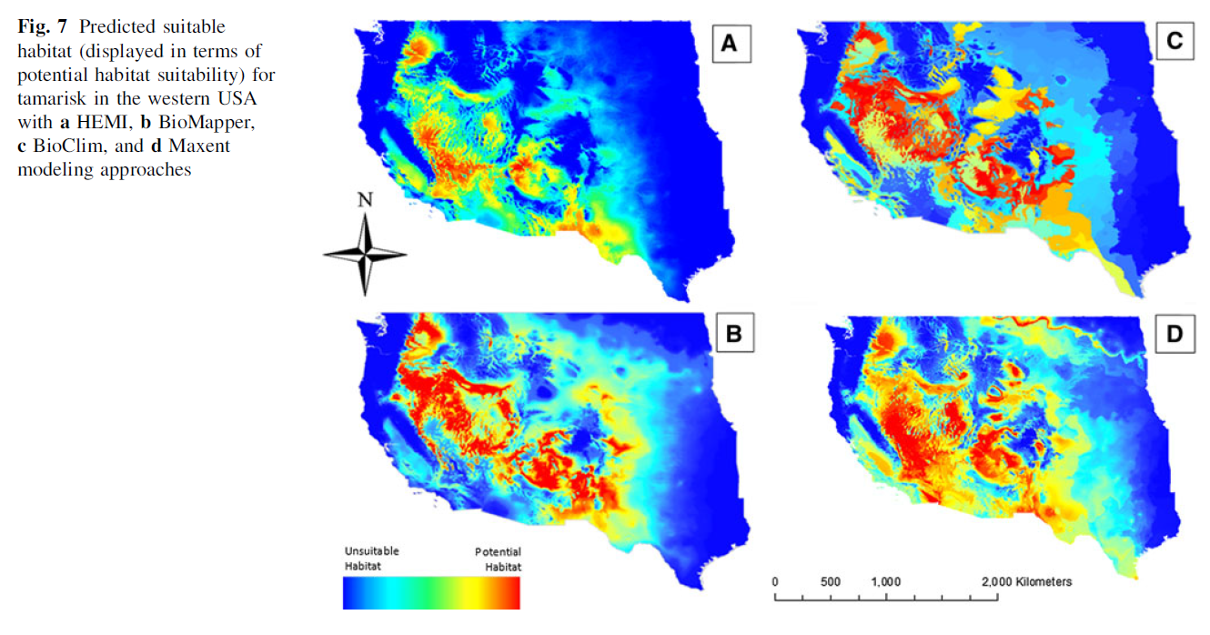

Slide 52
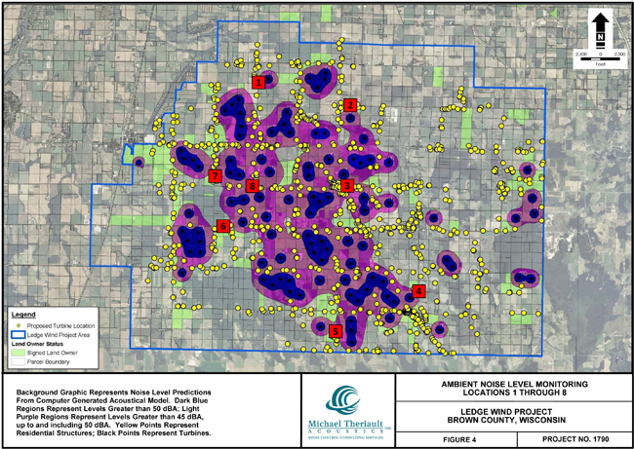

Slide 53
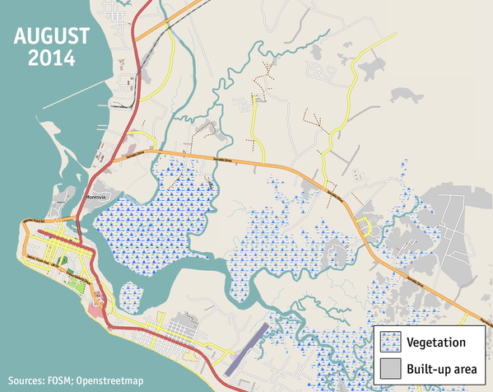

Slide 54
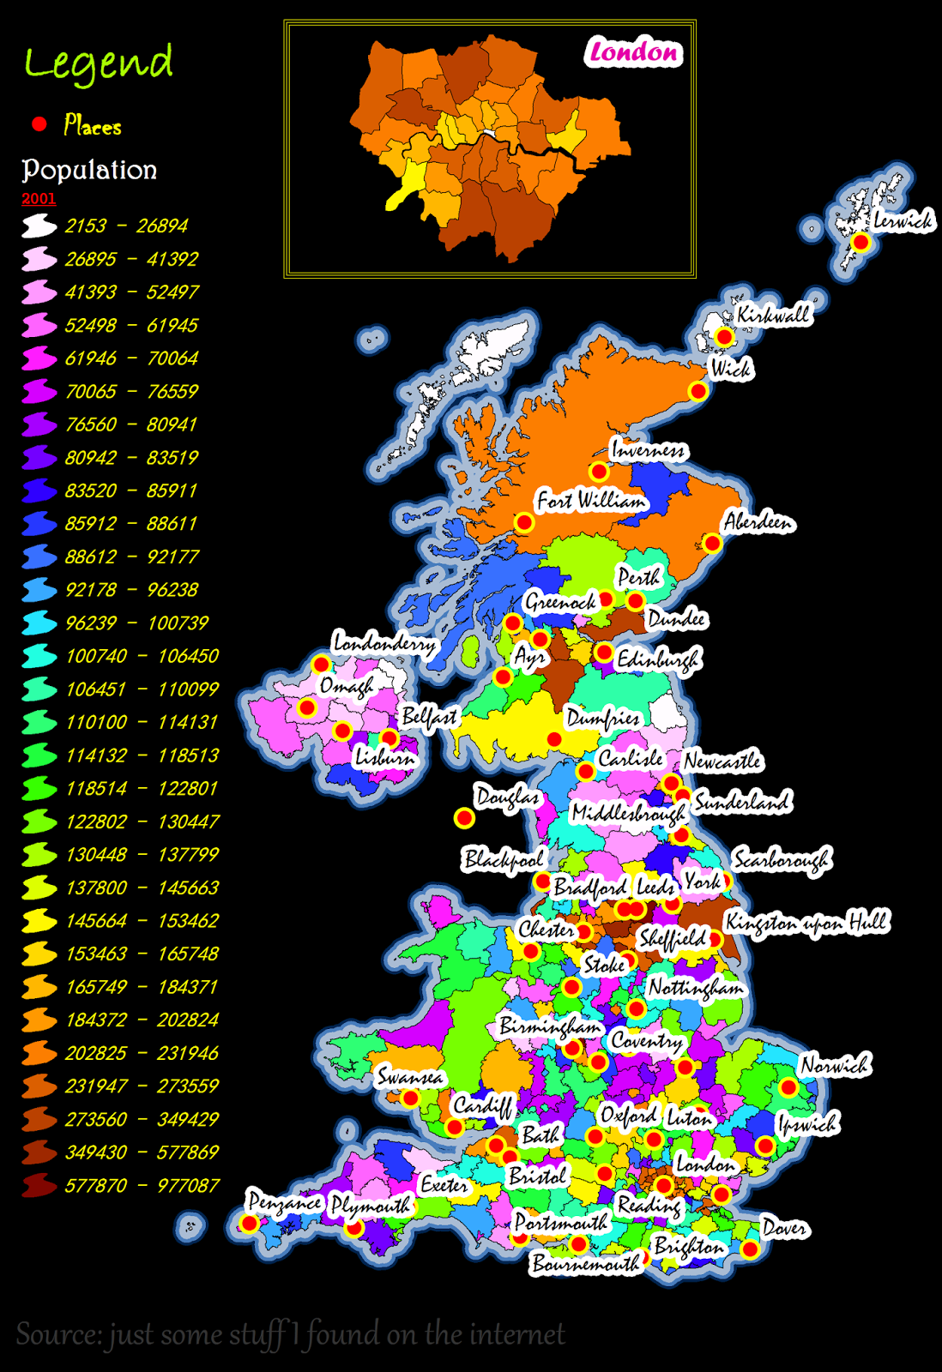
Don’t make ugly maps

Slide 55
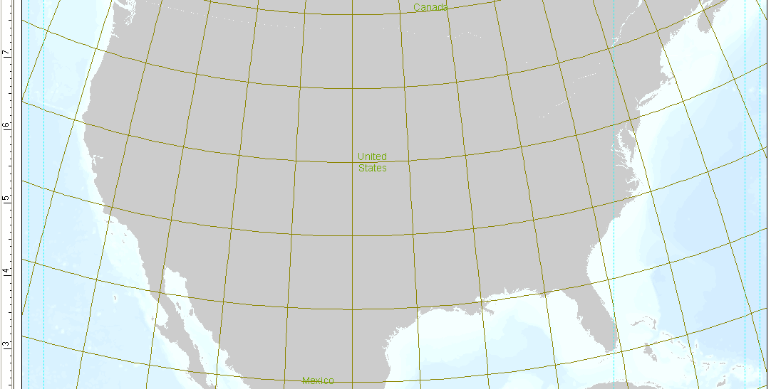
Cartography with ArcMap

Slide 56
ArcMap Views
Data View
Layout View
Good for manipulating layers
Only one data frame visible at a time
Zoom/pan moves map focus
Use for planning map output
Multiple data frames visible
Zoom/pan moves paper

Slide 57
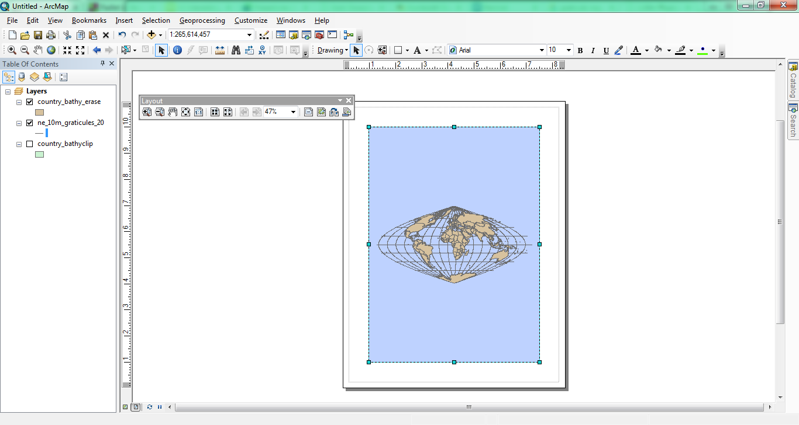
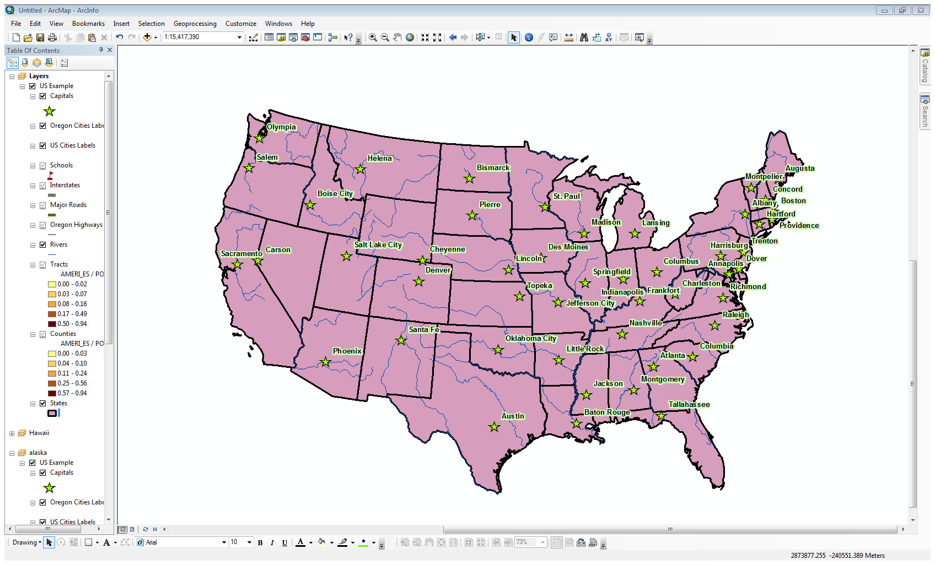
Data View

Slide 58
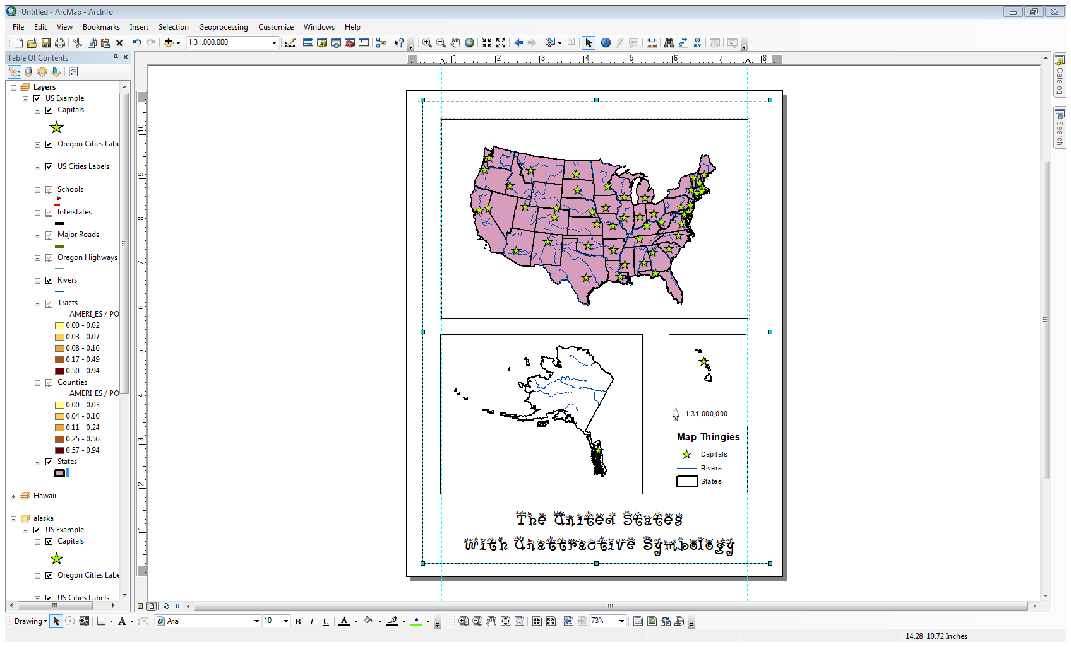
Layout View

Slide 59
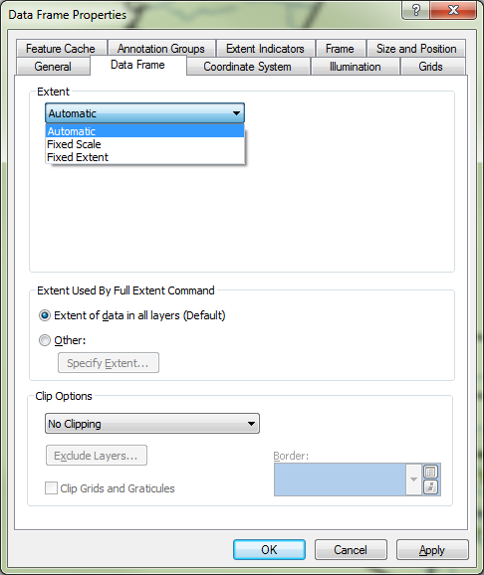
Arc’s Scale Interface
Auto
  Determined by zoom level; can change extent or scale
Fixed scale
  Set by you; size of data frame affects extent
Fixed extent
  Set by you; size of data frame changes scale

Slide 60
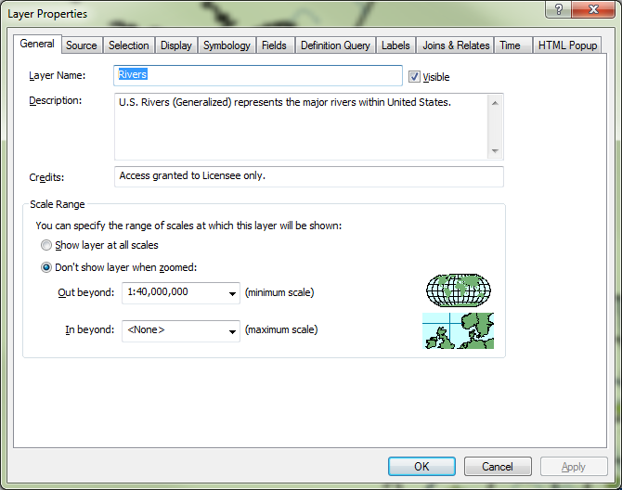
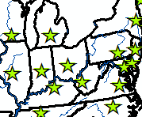
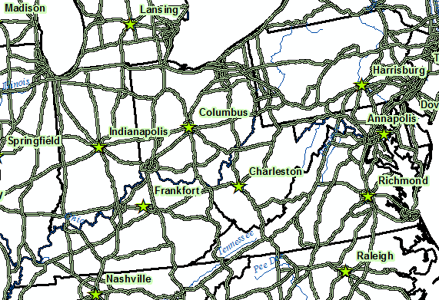
Scaling Features
Choose when to display certain features to aid readability

Slide 61
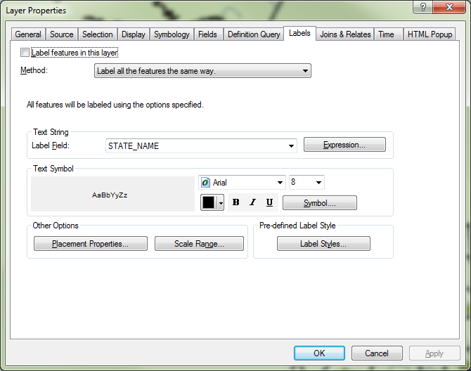
Labeling Features
Each layer has a default field for labeling
Many options beyond the default to improve your map labeling – don’t be afraid to experiment

Slide 62
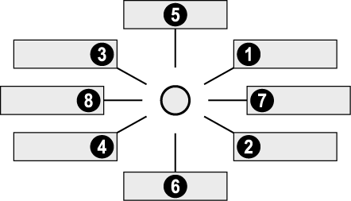
Labeling Rules
Positioning rules for point features
Rome
Rome
Rome
Rome
Rome
Rome
Rome
Rome

Slide 63
Titles and Other Text
Typography Principles
  PEOPLE READ THINGS IN CAPS MORE SLOWLY
  The 3-Font Rule is sacred. Two is better

Slide 64
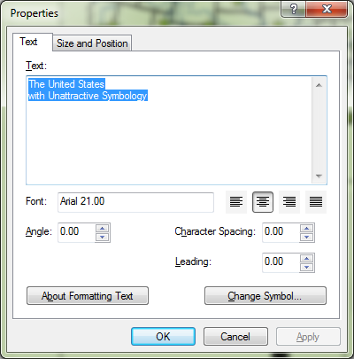
Text Interface
Default is Arial
Live a little, but don’t interfere with readability

Slide 65
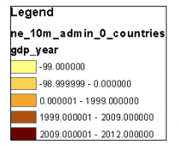
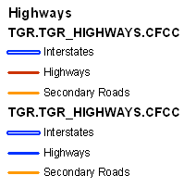
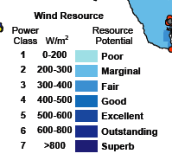
Legends
The Good, the Bad and the Ugly
Find something more useful than Legend for the title
The Legend Wizard is not really your friend – click through it, then come back and adjust things.

Slide 66
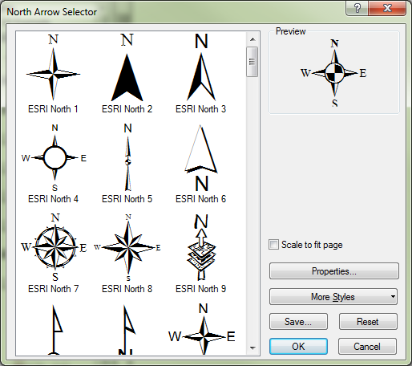
North Arrow
When do you need one?
Other directional options
  Grids and Graticules (more later)

Slide 67
Finishing the Map
Neatlines
Additional data frames
Check for balance
Get feedback from peers
Exporting/Printing
  For this class, you will usually export to JPG for inclusion in a report

