Slide 1
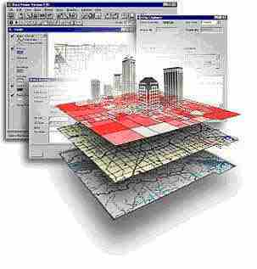
eographic nformation ystems
GSP 270
Introduction to
G
I
S
Concepts
Instructor: Jim Graham
E-mail: James.Graham@Humboldt.edu

Slide 2
Jim Graham
Bachelor's in CS and Math from Chico State
Over 20 years as a software engineer
15 with HP as an engineer and manager
Owner of tecBugs and now SchoonerTurtles
PhD from Colorado State U. in Forestry/GIS
Eight years with the Natural Resource Ecology Laboratory at Colorado State
Two years with Oregon State U.
15 years doing GIS, five years teaching GIS
Research with: State Dept., USGS, USDA, DOE…

Slide 3
But who am I really?
Grew up loving the mountains of California
Usually had a 24k topo in my back pocket
Discovered computers
Put together computers and maps to solve problems
After over 20 years in the commercial world, returned to academia to teach and help improve decisions on how we interact with the natural world

Slide 4
Who are you?

Slide 5
This class is about GIS
We will not cover everything you need to know to be successful
We will cover the basics and how to learn what you need to know to be successful

Slide 6
What is a GIS?
A Geographic Information System
Something (typically a computer) that provides information based on spatial data (locations of stuff)
Includes: ?

Slide 7
Why are we here?
Help get better careers
Improve the world for all living things

Slide 8
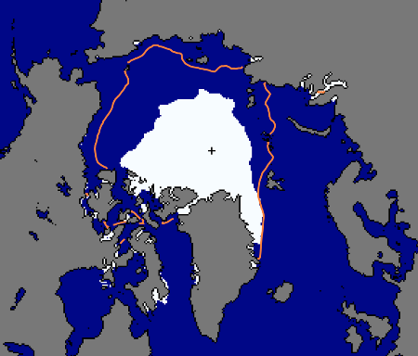
To Help Make Better Decisions
Sept. 24, 2012
National Snow and Ice Data Center, 2012

Slide 9
Antarctic Ozone Hole
Largest Antarctic Ozone Hole
September 2006

Slide 10
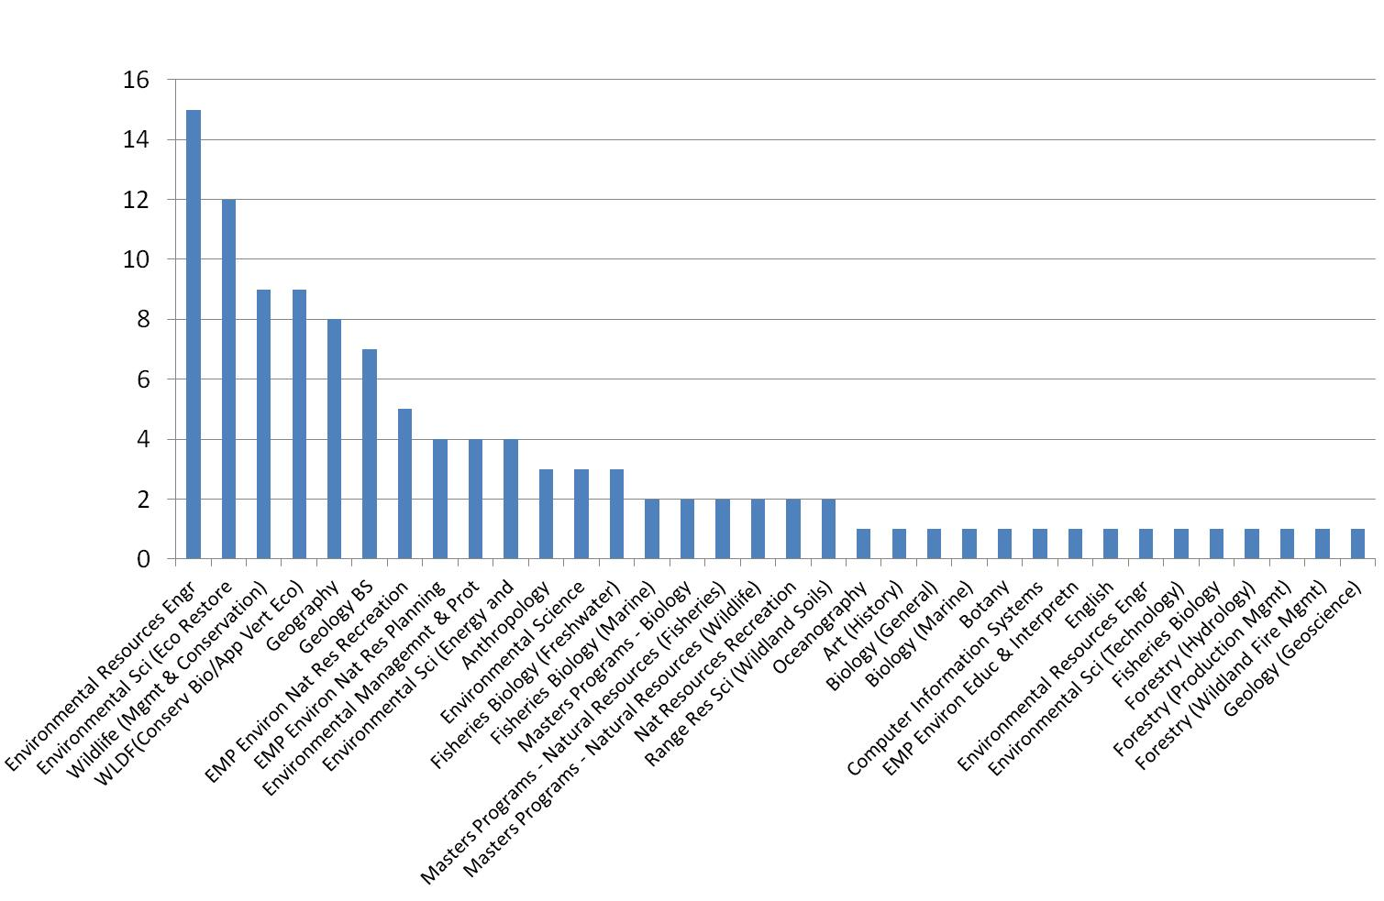
Who's using GIS?
“Bolstad: From Archeology to Zoology”

Slide 11
Is GIS a growing field?
GIS is a rapidly growing field:
Between 90,000 and 100,000 GIS-trained people in the world today (NASA, 2004). ¹
In 10 years, the US alone will need 1 million GIS workers (NASA, 2004).¹
Average salary of $52,750 in 2003
(A 7% increase over the 2000 survey). ³
Average salary of $60,050 in 2006
(A 13.8% increase over the 2003 survey) ³
The GIS software industry has been growing by 20% a year for many years (2002).²
¹ Doug Beed (NASA – EOS)
² GIS: An Introduction (T. Bernhardsen)
³ URISA http://urisa.org/

Slide 13
GIS is about:
Providing information and answering questions
With:
Reports
Maps
Posters
Web sites
From:
Spatial and aspatial data

Slide 14
What do you need from me?
In groups of about four people:
What are the top two things that either help you to learn or prevent you from learning?

Slide 15
Results from Fall 2013
P.P online
Experiences applied
Quasi-real projects
Other integration
Clear learning expectations
Reading pertinent
Step by step (bullets and numbers)
Keep up w/ grading
Specific feedback
Approachable (both class and out of class projects)
Fix IT
Data online
Realistic workload
Applicable questions
Email when not walking in
Examples
Hands on

Slide 16
Learning Opportunities
Reading and activities outside of class
Class presentations, discussions, and activities
Quizzes: individual and by groups
Lab assignments
What else?

Slide 17
Class Flow
Presentation
Poll
Activity
Discussion
PeerDiscussion
Poll 2

Slide 18
To be successful
Turn in lab assignments on time!
Attend class, read the book, etc.
Make good decisions
Follow the 20 minute rule:
If you’re stuck more than 20 minutes, get help
What is your learning style?
www.vark-learn.com/english/page.asp?p=questionnaire

Slide 19
What I need from you:
Please turn off phones or set to vibrate
Please try to make it to class on time,
If you’re late, please come in quietly
If you have a question, please ask
Others may be wondering about the same topic

Slide 20
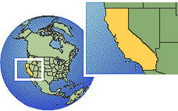
Bottom Line
The more time you spend working with a GIS, the better you will do
If you work hard and do the assignments on time
Me (and others) will be there to help you when needed
You just need to ask!
Be ready to help others as well

Slide 21
The Class Content
Moodle:
Grades
Forums
Link to the class web site with readings and activities
Lab:
Additional lab information and data

Slide 22
Extra Credit
There are lots of opportunities for extra credit but time is always the challenge
If you think you’ll need extra credit, start early
I give 1 point for attending a presentation/conference/meeting that includes spatial content and a short write-up (one paragraph)
Another point if you provide a critical, yet constructive review (another paragraph)
Note: 1 point = 1 percent of your overall grade

Slide 23
A few other things…
There will be a lab assigned this week and due next week!
Don’t forget to read Bolstad Chapter 1 this week.

