Slide 1
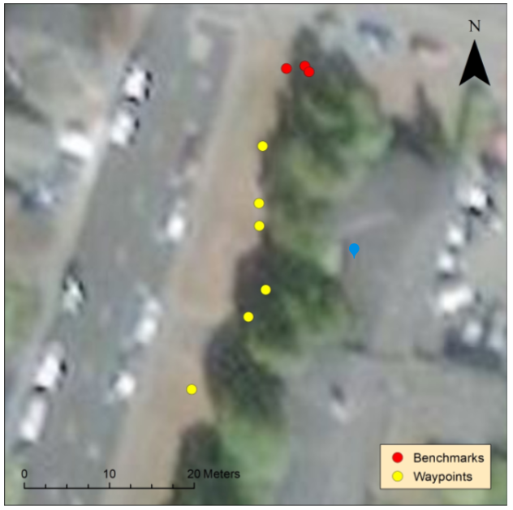
Chelsea Polevy

Slide 2
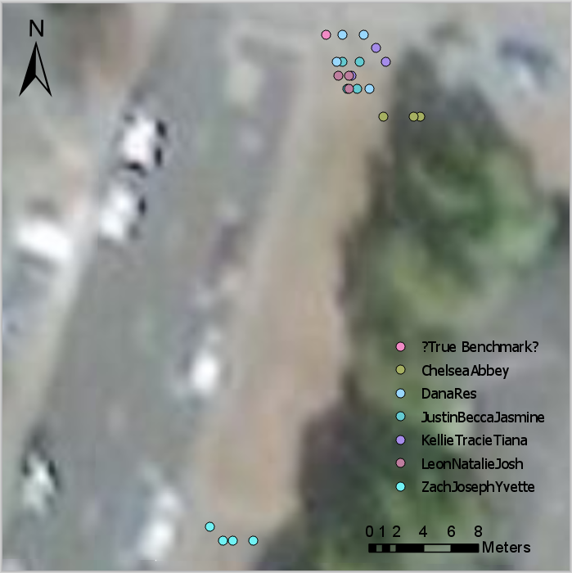

Slide 3
Benchmark Results
Standard Deviation:
  Eastings: 4.2 meters
  Northings: 13.3
RMSE:
  Eastings: 4.2
  Northings: 16.0

Slide 4
Common Report Issues
Credit for background
Group acknowledgements
Credits in map
  Search Web for “arcmap remove basemap credits”
Same symbols
  Benchmark and surveys are different
  Multiple symbols then require a legend
“x-projection”
  X-Direction, X Coordinate Value, or Easting

Slide 5
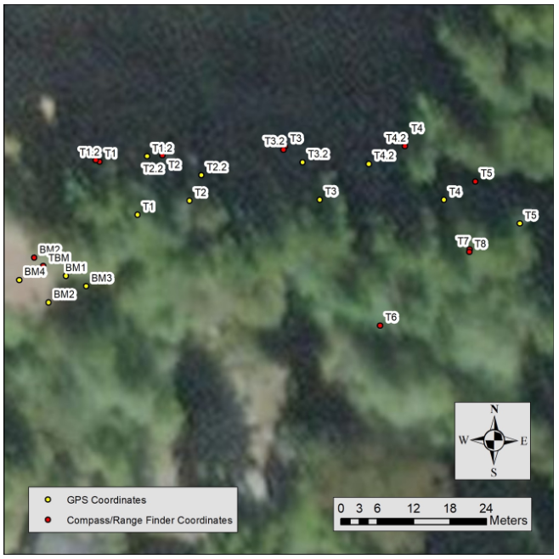
Yvette Lindler

Slide 6
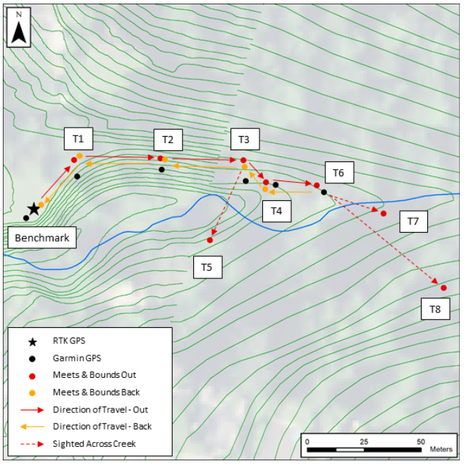
Kevin Landow
Notes:
Kevin

Slide 7
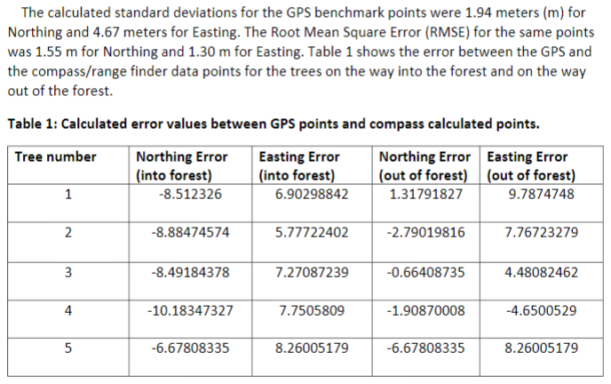
Emma Levy

Slide 8
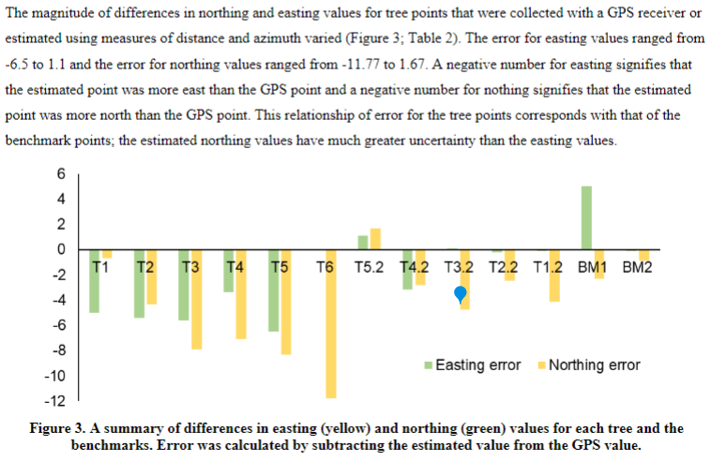
Jasmine Shen

Slide 9
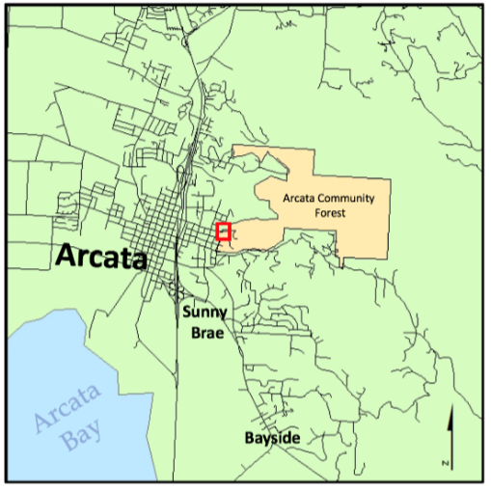

Slide 10
Lab 4
In MS-Excel:
  RMSE
  Std. Dev.
Projection Method vs. Map “y_proj”
Coordinates:
  Easting, Northing
  Lat/lon
  x,y

Slide 11
Review
Backgrounds w/gaps
Removing credits
Removing legend title
Scale bar units
Renaming legend entries to get rid of underscores

