Slide 1
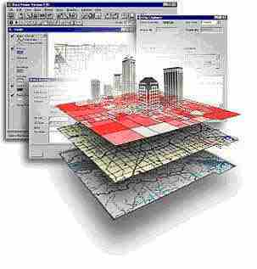
GSP 270
Acquiring Digital Data
Reading Assignment: Bolstad Chapter 7

Slide 2
Finding Data
There are standard web “portals” and “warehouses” for data
Search the web for “shapefile <your interest>” or “GIS Data <your interest>”
Talk to other GIS folks about where the good data is and how to get it
Check metadata for sources

Slide 3
Process of Acquiring
Find the data
Check the online documentation
Download it (1 second to several days)
Un-compress, un-compress, un-compress
Save it locally with documentation
Qualify the data
Check the spatial reference
Perform a visual inspection
Check the meta data
Projection into the projection you desire
Notes:
Saving it locally really mean to place it in a file-folder structure that is organized so you can find the data later.

Slide 4
File Formats
Raster
Vector
Tagged Image File Format (TIFF)
GeoTIFF
Imagine (IMG)
Joint Photographic Experts Group (JPEG)
Esri Grid
MrSID
BIP, BMP, DEM, and many more…
Points:
Tabular data
Geocoded
Individual points
Shapefiles
E00 – Compressed coverage file
Spatial Data Transfer Standard (SDTS)
DXF – AutoCAD

Slide 5
Complex Formats Raster and Vector
Personal Geodatabase – needs to go away
File Geodatabase – commercial, compatibility problems, needs to be zipped
KML – Keyhole markup language
ZML – A zipped KML

Slide 6
Sources
Global:
Natural Earth
United Nations
CIA
United States:
National Map (not really)
NOAA
USGS
NASA
Individual agencies
States
Counties
Cities (some)
Commercial
Typically have costs
Other countries

Slide 7
Global Data
Natural Earth – vector for cities, countries, etc.
United Nations – Economy, social issues
CIA – National histories
EROS Data Center – Satellite
Others, see SEER web site

Slide 8
United States
National Atlas – Great for vector data on counties, zip codes, census, etc.
National Map - ?
NASA– Raw satellite data and metadata
USGS – Earth Explorer & Stream gage data
NOAA – Weather and marine data
Individual agencies
Topo Quest – Topos (DRG)
USDA Geospatial Gateway
Data.gov
GeoComm – Commercial with some free data

Slide 9
National Map
National Map: Intended to be the main point for distribution of US government data.
Has yet to live up to this
It does work periodically now and you can get data out of it sometimes
They plan on making it much simpler in the future (which should be good!)

Slide 10
California
CaSIL (CalAtlas)
Fire Resource Protection Program (FRAP)
Ocean Protection Council

Slide 11
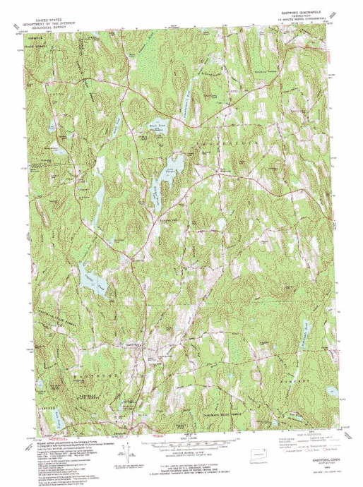
Digital Data
DRGs (Digital Raster Graphics)
Scanned USGS topographic quads
TIFF or Mr. Sid format
Georeferenced
Heads up digitizing
When displaying new data.
Acquire at CaSIL
http://www.atlas.ca.gov/download.html

Slide 12
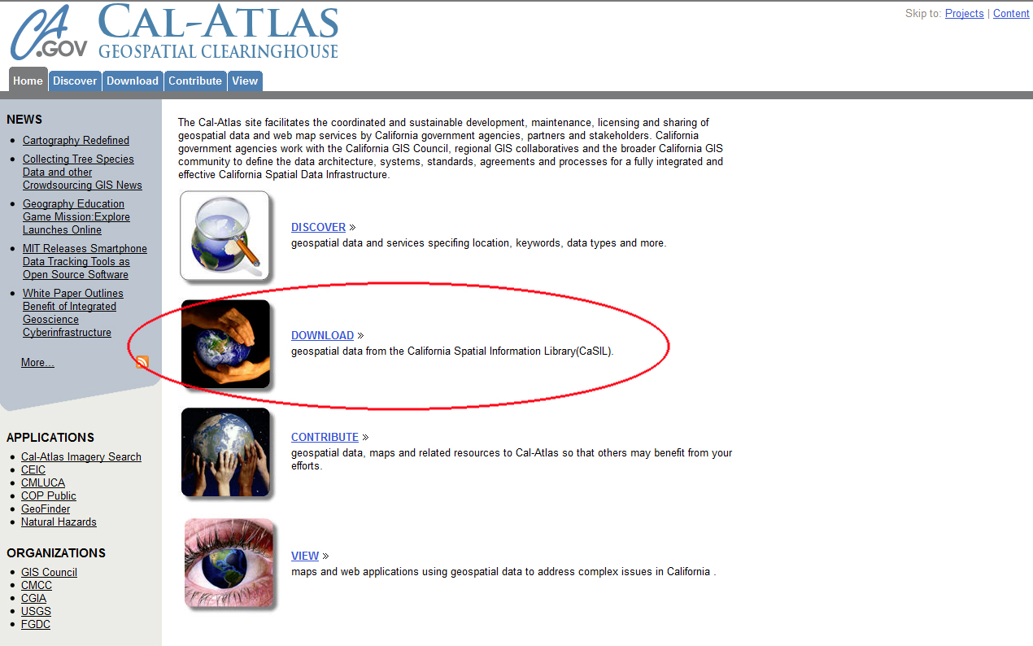
http://atlas.ca.gov/

Slide 13
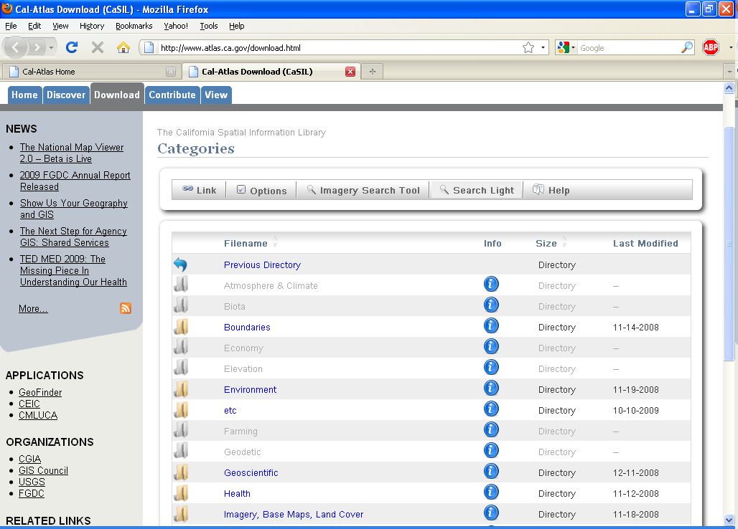

Slide 14
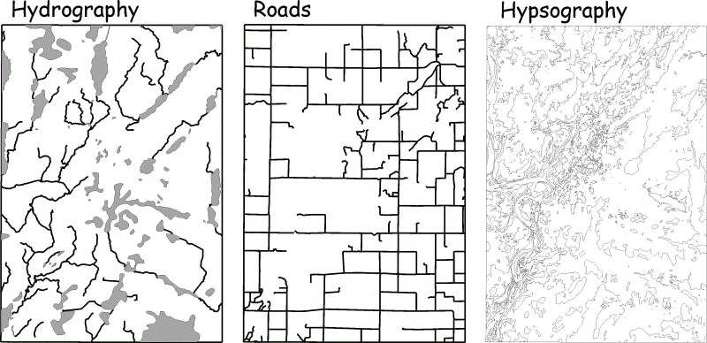
Digital Data
DLGs (Digital Line Graphs)
Vector representations of many of the features on USGS topographic quadrangles
Transportation
Hypsography (elevation contours)
Hydrography (lakes, rivers, glaciers, etc.)
Boundaries (political and administrative)
Vegetation features
Non-vegetation features (sand, gravel, lava, etc)
Control points
Man made features
Acquire at USGS: http://eros.usgs.gov/

Slide 15
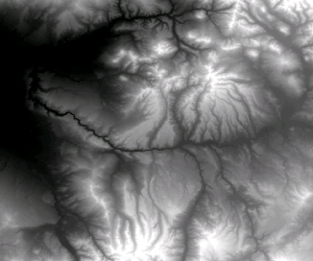
Digital Data
DEMs
Provide elevation data in a raster format.
Available for most of the earth.
30m or 10m
Acquire at:
USGS EarthExplorer

Slide 16
Coastal Mapping (LiDar)

Slide 17
Coastal Mapping (LiDar)
No Community Forest Data

Slide 18
Digital Data
DOQs and DOQQs
(Digital Ortho Quads/Quarter Quads)
Scanned aerial photographs
Production led by USGS
Began in 1991
1 meter resolution
Most are Black and White
Georeferenced to UTM (usually)
Available for much of the US
Acquire at CaSIL

Slide 21
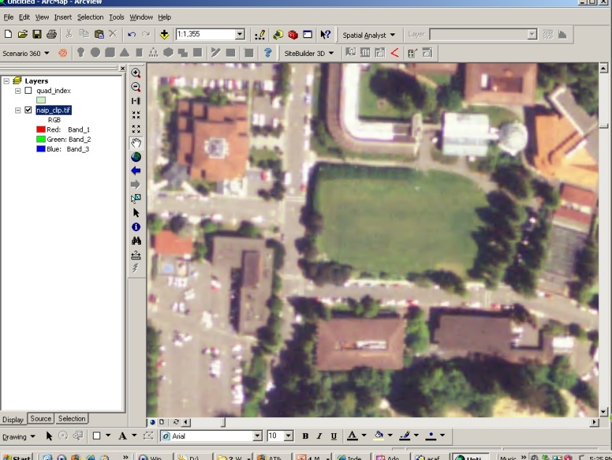
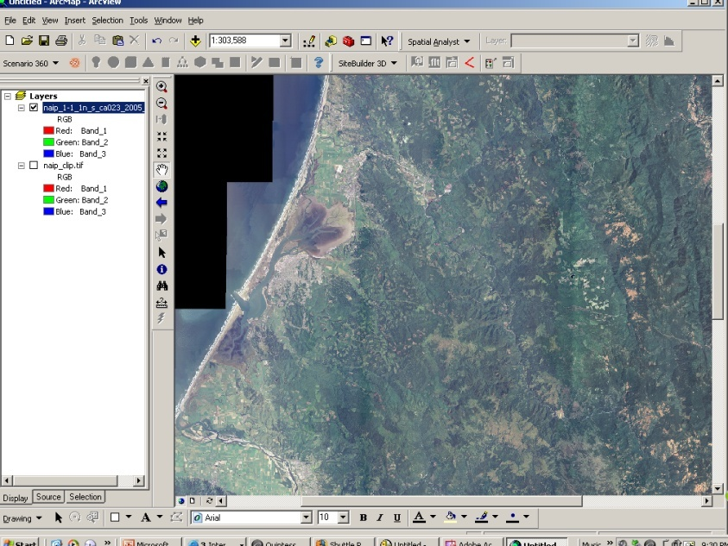
Digital Data
NAIP Imagery
National Agriculture Imagery Program
Began in 2003
USDA
Agricultural surveys
Crop yield estimates
1 m spatial resolution
True color composites (RGB)
Some infrared products
Georeferenced to UTM (NAD83)
Acquire: CaSIL (CA) Free

Slide 22
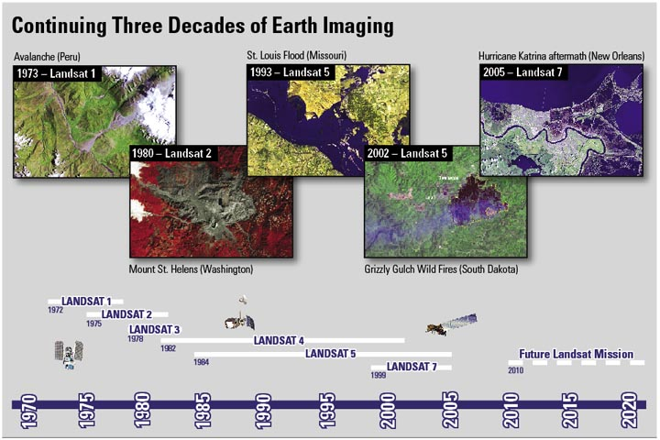
Landsat Imagery
USGS and NASA
LANDSAT 8
Feb 11, 2013

Slide 23
Landsat 8 – March 18, 2013

Slide 24
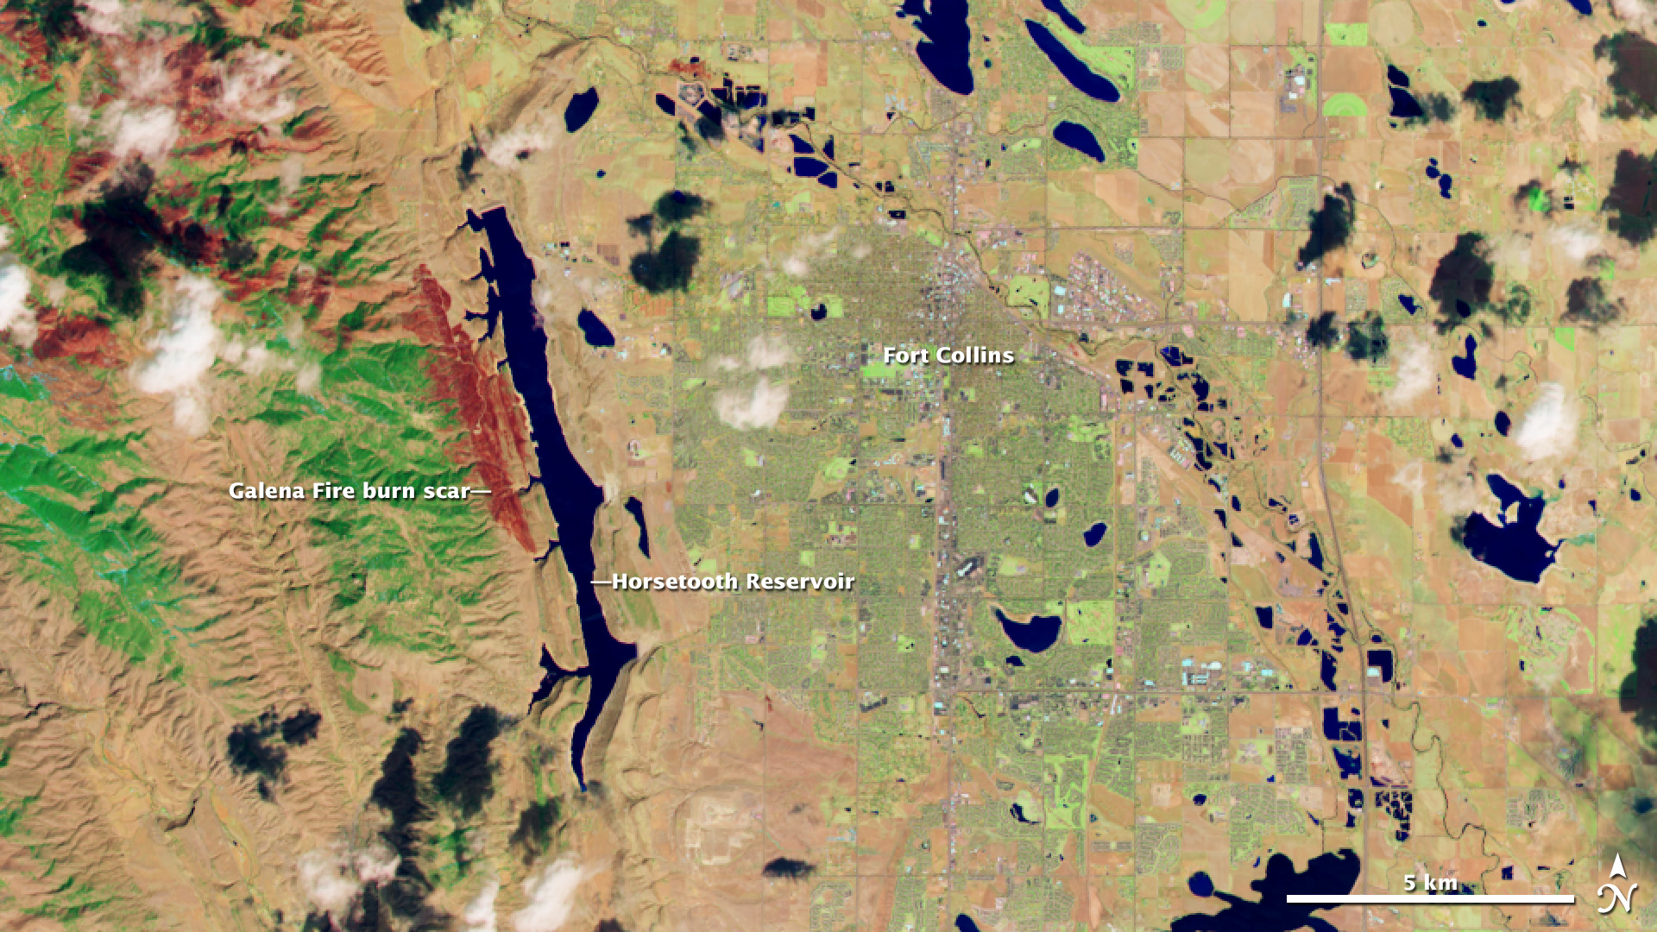
Landsat 8 – March 18, 2013

Slide 25
Landsat 8 – March 18, 2013

Slide 26
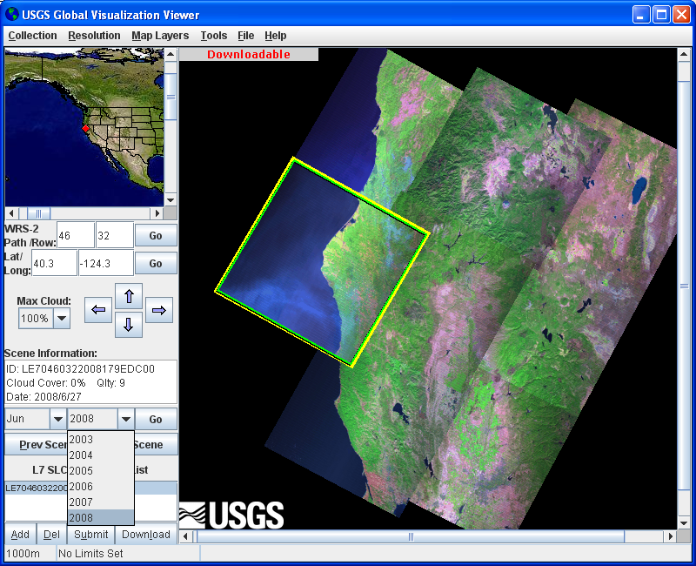
USGS GLOVIS http://glovis.usgs.gov/

Slide 27
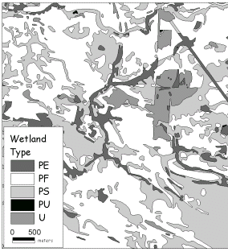
Digital Data
National Wetlands Inventory
Agency: US Fish and Wildlife Service.
Data on the location, condition, and characteristics of wetlands.
Acquire from NWI
http://www.fws.gov/wetlands/Data/

Slide 28
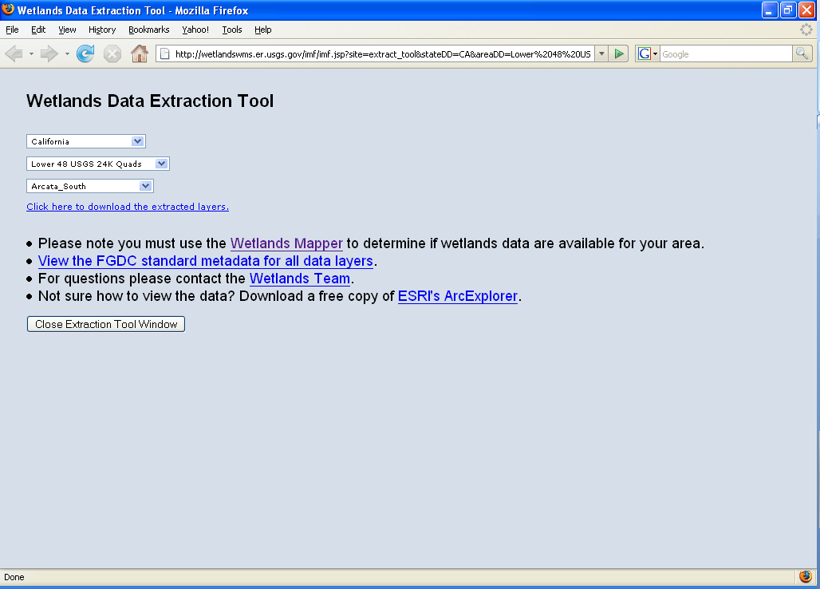

Slide 29
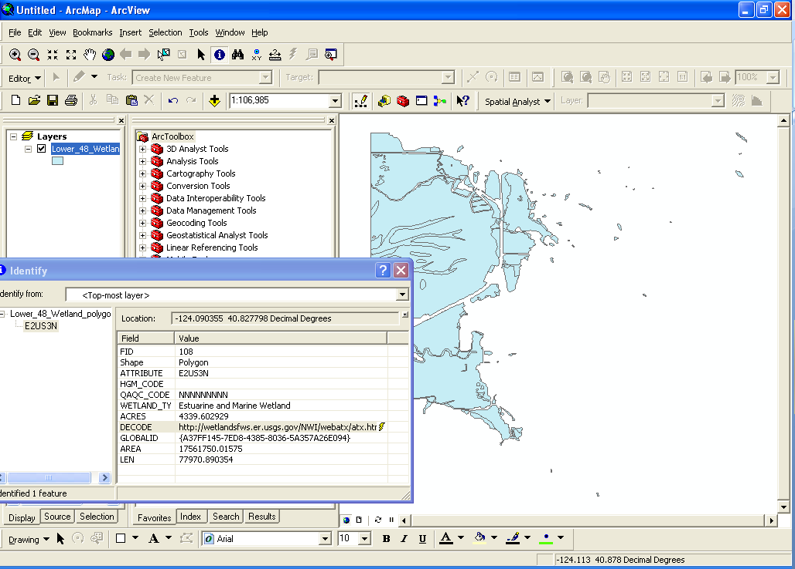
Hyperlinked

Slide 30
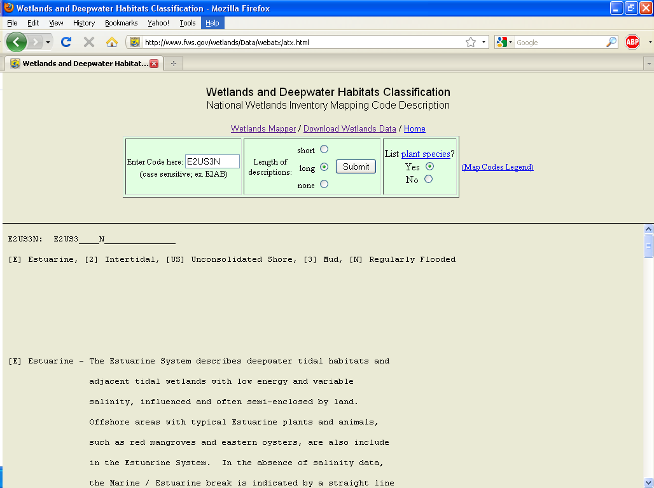

Slide 31
Digital Data
Hydrologic Data
The National Hydrography Dataset (NHD)
Rivers, streams, canals, ditches, lakes, ponds, springs, wells, canals, pipelines, dams.
Based on 1:100,000 scale USGS DLG data.
Acquire from USGS http://nhd.usgs.gov
CaSIL’s Hydrography Layer for California
Digitized from1:24,000 scale USGS Topo quads.
Acquire from http://www.atlas.ca.gov/download.html
Inland waters -> Hydrologic features

Slide 32
Digital Data
Bolstad…
The National Atlas (USGS)
http://www.nationalatlas.gov/
The National Atlas: Raw Data Download
http://www.nationalatlas.gov/atlasftp.html

Slide 34
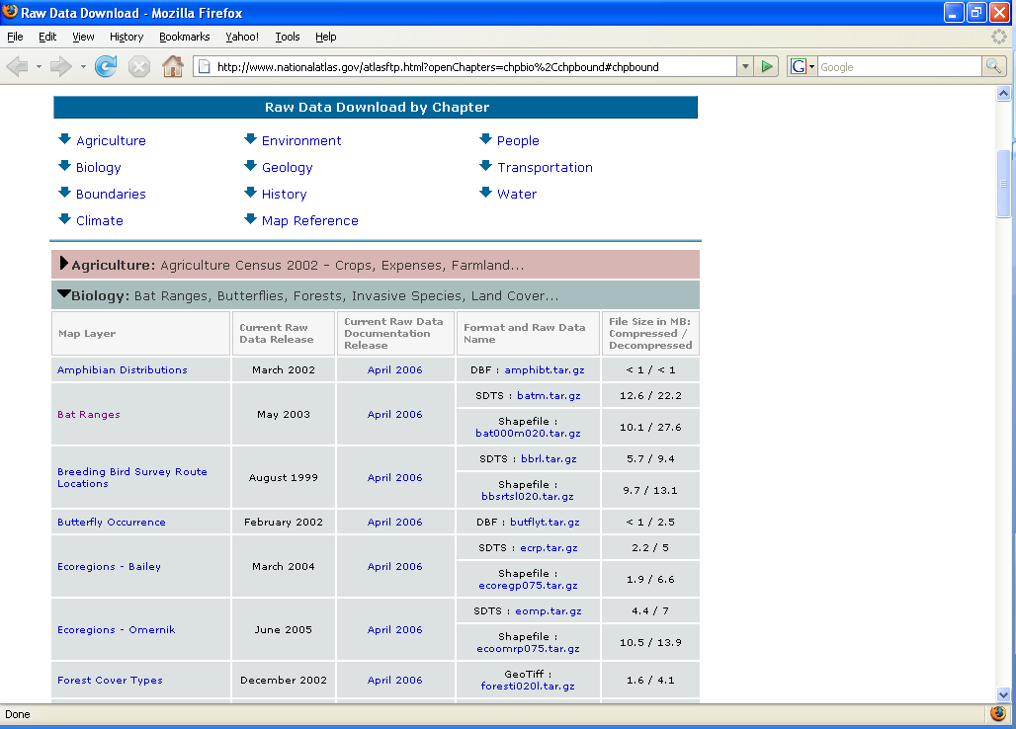

Slide 35
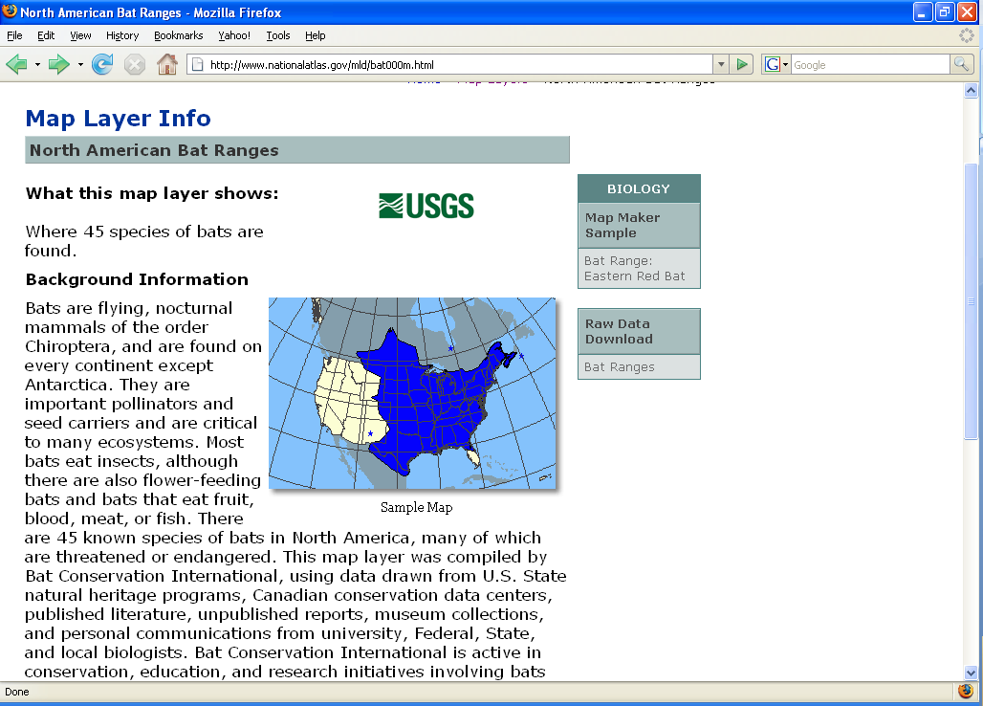

Slide 36
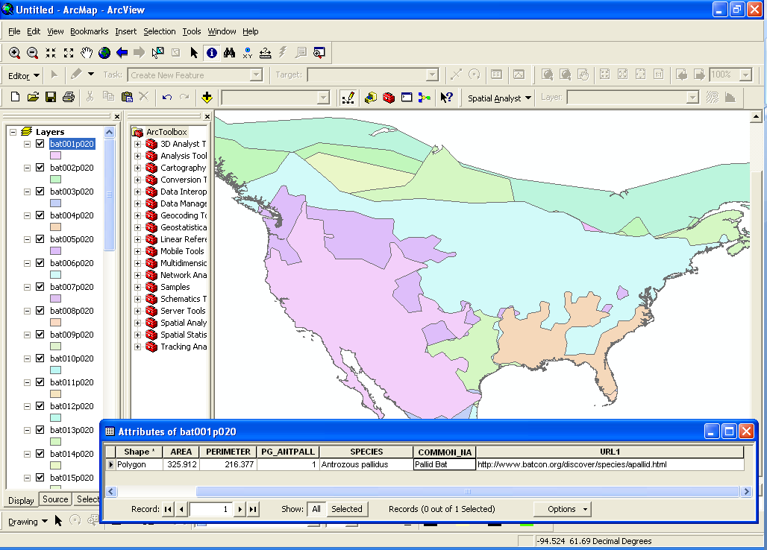

Slide 37
Digital Data
Land Use & Land Cover
USGS Land Use Land Cover (LULC)
Derived from Aerial Photographs
National Land Cover Database (NLCD)
Derived from Landsat imagery
http://www.mrlc.gov/index.asp
2 National Datasets:

Slide 38
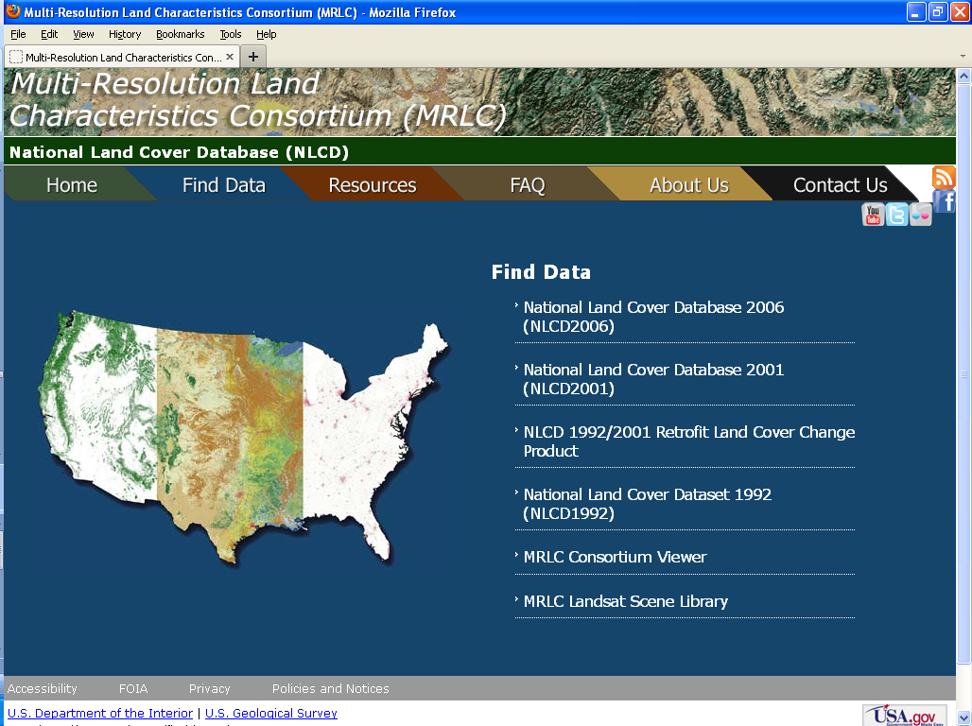

Slide 40
WHRNUM WHRTYPE WHRNAME
------ ------- -----------------------------
1 ADS Alpine-Dwarf Shrub
2 AGR Agriculture
3 AGS Annual Grassland
4 ASC Alkali Desert Scrub
5 ASP Aspen
6 BAR Barren
7 BBR Bitterbrush
8 BOP Blue Oak-Foothill Pine
9 BOW Blue Oak Woodland
10 COW Coastal Oak Woodland
11 CPC Closed-Cone Pine-Cypress
12 CRC Chamise-Redshank Chaparral
13 CSC Coastal Scrub
14 DFR Douglas-Fir
15 DRI Desert Riparian
17 DSC Desert Scrub
18 DSS Desert Succulent Shrub
19 DSW Desert Wash
20 EPN Eastside Pine
21 EST Estuarine
22 FEW Freshwater Emergent Wetland
24 JPN Jeffrey Pine
25 JST Joshua Tree
26 JUN Juniper
27 KMC Klamath Mixed Conifer
28 LAC Lacustrine
29 LPN Lodgepole Pine
30 LSG Low Sage
31 MAR Marine
32 MCH Mixed Chaparral
34 MCP Montane Chaparral
35 MHC Montane Hardwood-Conifer
36 MHW Montane Hardwood
37 MRI Montane Riparian
39 PGS Perennial Grassland
40 PJN Pinyon-Juniper
41 POS Palm Oasis
42 PPN Ponderosa Pine
43 RIV Riverine
44 RDW Redwood
45 RFR Red Fir
48 SCN Subalpine Conifer
49 SEW Saline Emergent Wetland
50 SGB Sagebrush
51 SMC Sierran Mixed Conifer
53 URB Urban
55 VOW Valley Oak Woodland
56 VRI Valley Foothill Riparian
57 WAT Water
58 WFR White Fir
59 WTM Wet Meadow
62 CHP Unknown Shrub Type
63 CON Unknown Conifer Type
72 PAS Pasture
77 EUC Eucalyptus
Digital Data
California Land Cover Data
Agency: The Department of Forestry and Fire Protection (CDF)
– Fire Resource Protection Program (FRAP)
Multi-source Land Cover Data (v02_2)
Compiled for Forest and Range 2003 Assessment
Acquire at http://frap.cdf.ca.gov/data/frapgisdata/select.asp

Slide 41
Digital Data
Digital Census Data
Agency: The US Census Bureau
TIGER System
(Topologically Integrated Geographic Encoding and Referencing)
Spatial Data derived from the national census (household).
Distributed:
By state, county, census tract, census block, etc.
Links geographic units to statistical data (population size, age, income, health, etc).
Roads, hydrography, political boundaries, schools, parks…
Acquire from
http://www.census.gov/geo/www/tiger/
www.arcgis.com

Slide 42
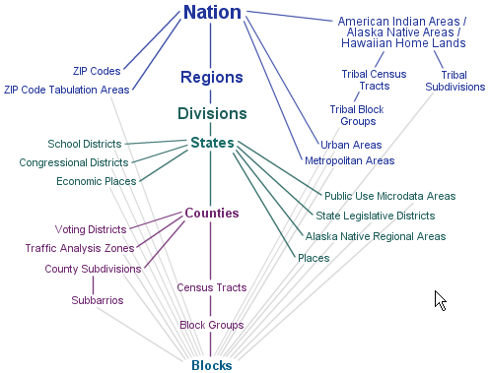
Digital Data
Census
Boundary
Enumeration
Levels

Slide 43
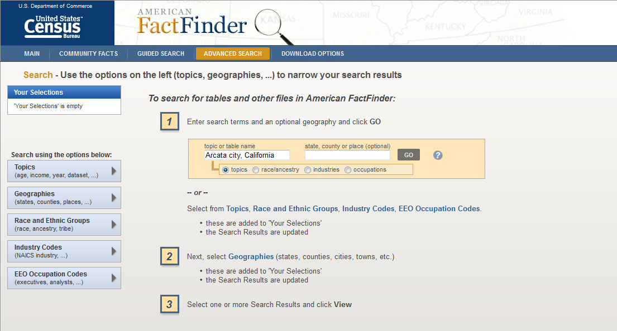
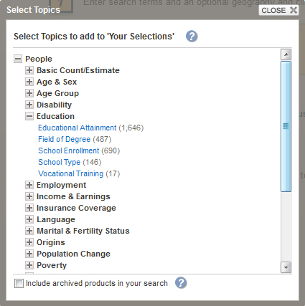
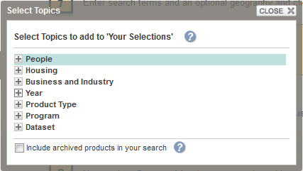
Digital Data

Slide 44
