Slide 1
First…
ArcMap is really picky
If you’re having problems with a CSV:
  Check the file in NotePad or NotePad++
    Excel will hide characters and reformat your data!
  Header names must be 10 letters or less, no punctuation or spaces
  No special characters in cells
  BlueSpray and QGIS are less picky
For this assignment, GoogleDocs did something bad.

Slide 2
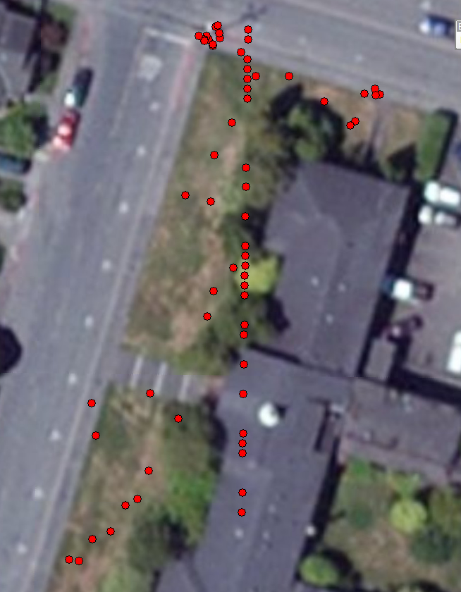

Slide 3
What happened?
Group | Benchmark Location | NAME | Latitude | Longitude | y_proj | x_proj
 |  | 2 | 40.871813 | -124.080055 | 40.871813 | -124.080055
 |  | 3 | 40.871803 | -124.080047 | 40.871803 | -124.080047
 |  | 4 | 40.871804 | -124.080047 | 40.871804 | -124.080047
 |  | 5 | 40.871809 | -124.080058 | 40.871809 | -124.080058
 |  | 6 | 40.871809 | -124.080059 | 40.871809 | -124.080059
 |  | 7 | 40.871809 | -124.080059 | 40.871809 | -124.080059
 |  | 8 | 40.871809 | -124.080059 | 40.871809 | -124.080059
 |  | 9 | 40.871808 | -124.080058 | 40.871808 | -124.080058
 |  | 10 | 40.871808 | -124.080058 | 40.871808 | -124.080058
 |  | 11 | 40.871773 | -124.079989 | 40.871773 | -124.079989
 |  | 12 | 40.871773 | -124.079944 | 40.871773 | -124.079944
 |  | 13 | 40.871813 | -124.080066 | 40.871813 | -124.080066
 |  | 14 | 40.871651 | -124.080081 | 40.871651 | -124.080081
 |  | 15 | 40.871554 | -124.080042 | 40.871554 | -124.080042
 |  | 16 | 40.871822 | -124.080043 | 40.871822 | -124.080043
 |  | 17 | 40.871371 | -124.080125 | 40.871371 | -124.080125
 |  | 18 | 40.87128 | -124.08023 | 40.87128 | -124.08023
 |  | 19 | 40.871824 | -124.08004 | 40.871824 | -124.08004
 |  | 3 | 40.87155 | -124.08 | 4525059 | 408982.7
 |  | 4 | 40.8716 | -124.08 | 4525065 | 408983.3
 |  | 5 | 40.87145 | -124.08 | 4525048 | 408979.6
 |  | 6 | 40.87141 | -124.08 | 4525044 | 408980.5
 |  | 7 | 40.87135 | -124.08 | 4525037 | 408977.8
 |  | 8 | 40.87139 | -124.08 | 4525041 | 408976.2
 | South Stairs | B01 | 40.87148 | -124.08 | 4525052 | 408979.4
 | South Stairs | B02 | 40.87148 | -124.08 | 4525052 | 408979.8
 | South Stairs | B03 | 40.87148 | -124.08 | 4525051 | 408979.4

Slide 4
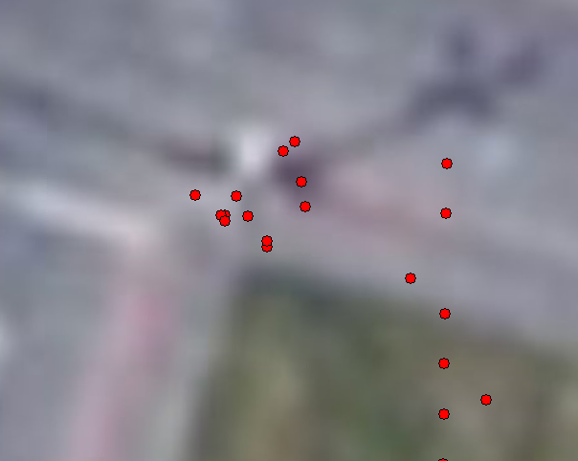
What happened?

Slide 5
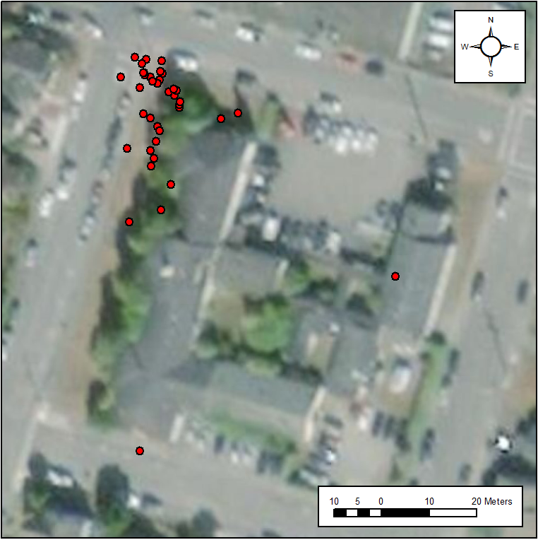
How did we do?
Notes:
Results from GSP 510, Fall 2018

Slide 6
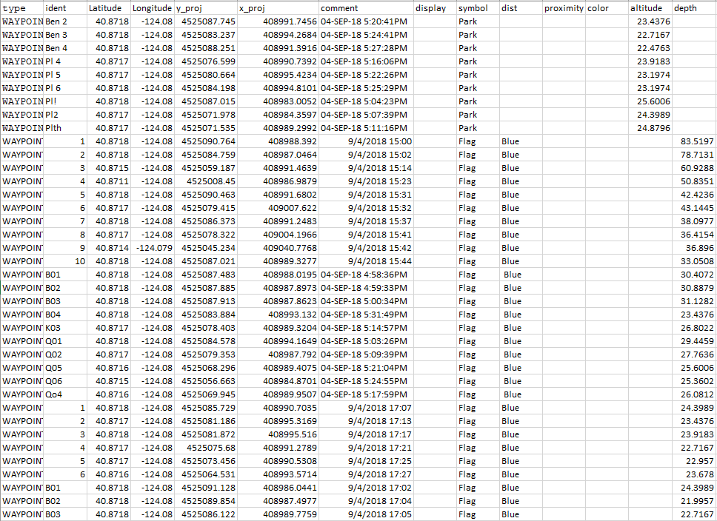
Notes:
Results from GSP 510, Fall 2018

Slide 7


Accuracy and Precision
High Accuracy
Low Precision
Low Accuracy
High Precision
http://en.wikipedia.org/wiki/Accuracy_and_precision
Notes:
These are the formal terms, accuracy is often used to refer to uncertainty in general

Slide 8
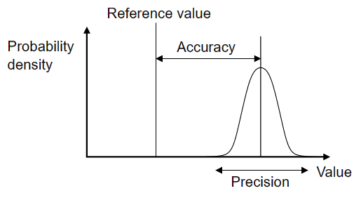
Accuracy and Precision
Accuracy = distance from truth
Precision = repeatability
Wikipedia

Slide 9
Precision
Estimate:
  Standard Deviation: Precision
  Standard Error: Precision
  Confidence Interval: Precision
  Min/Max: Precision
Manage:
  Significant Digits
  Data types: Doubles, Long Integers
Report

Slide 10

Standard Deviation (Precision)
Each band represents one standard deviation
Source: Wikipedia
Notes:
10

Slide 11
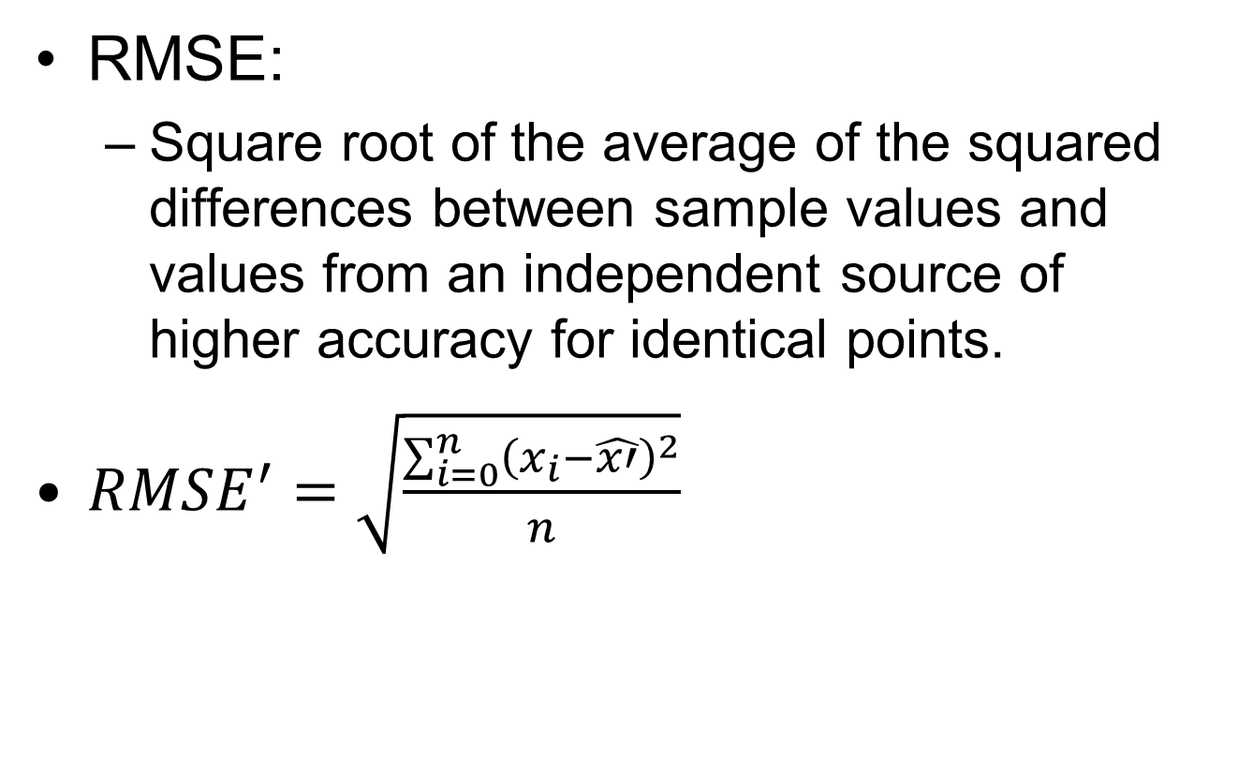
RMSE From Higher Accuracy

