Slide 1
Trees
Nodes
Is Temp>30?
False
True
Temp<=30°
Temp>30°
Is Temp<0?
True
False
Dies
Temp<0°
Temp>=0°
Dies
Lives
Terminal or Leaf Nodes

Slide 2
Trees
Classification Trees
  Predicted outcome is a class (cover type)
Regression Trees
  Predicted outcome is a value (percent)
Boosted Trees
  Combines classification and regression trees
Random Forests
  Combines many trees to improve fit

Slide 3
Classification Trees
Reflectance < 0.1
True
False
Water
Reflectance > 0.9
True
False
Snow or Cloud
Ground

Slide 4
Classification Tree
Water
Ground
Snow or Cloud
0.0
0.1
0.9
1.0
Reflectance
Notes:
Group activity, draw the tree for this data.

Slide 5
Regression Trees
Precipitation < 0.5
True
False
Precipitation < 0.1
Precipitation < 0.9
True
False
True
False
Suitability=0.0
Suitability=0.3
Suitability=0.5
Suitability=0.0

Slide 6
Regression Trees
1.0
0.5
Suitability
0.3
0.0
0.0
0.1
0.5
1.0
Precipitation

Slide 7
Trees
Classification and Regression Trees
Predictors can be continuous or categorical
Easy to interpret and understand
Robust
Easy to validate
Statistical methods well understood
Can still make really complex trees that over fit the data!

Slide 8
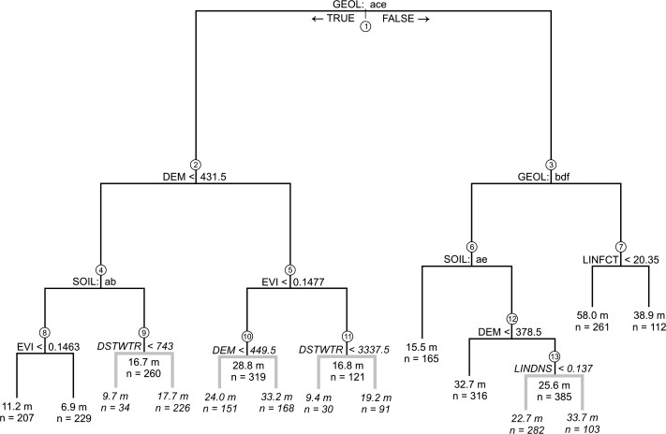
Regression Trees in GIS
Geospatial and regression tree analysis to map groundwater depth for manual well drilling suitability in the Zinder region of Niger

Slide 9
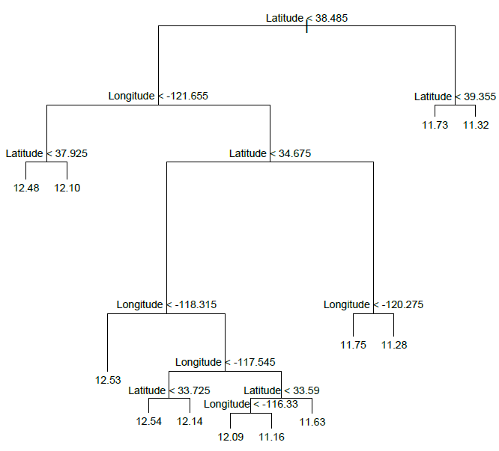
CA Housing Prices

Slide 10
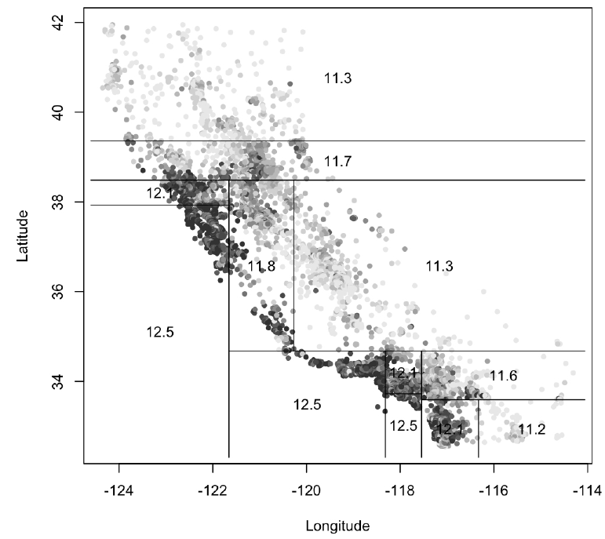
CA Housing Prices

Slide 11
Building Trees
Goals:
  Find the tree with the least number of “nodes” (branches) that best represents the phenomenon
Approach:
  Minimize the “deviance” that the samples have from the model

Slide 12
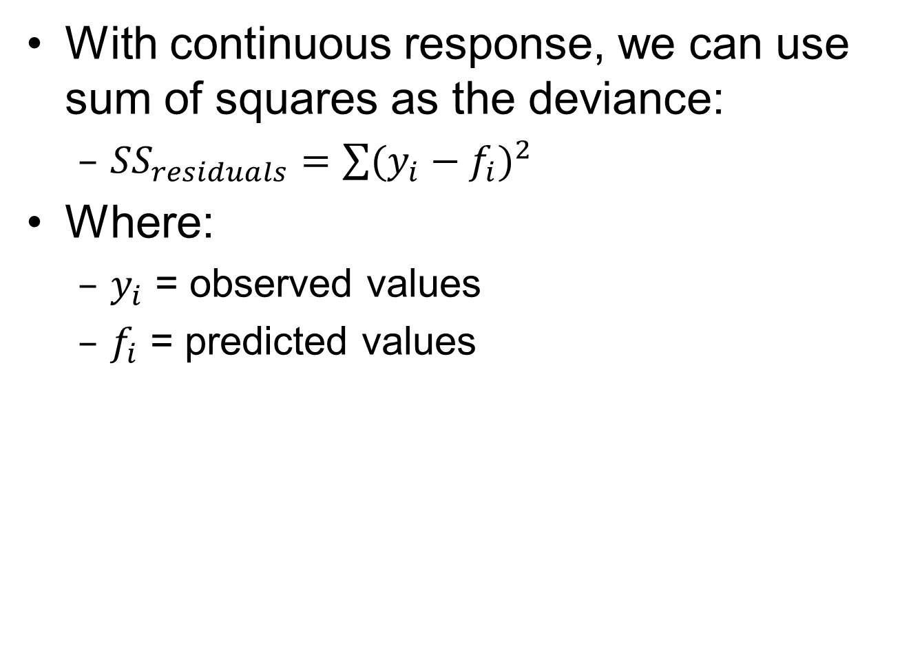
R squared
With continuous response, we can use sum of squares as the deviance:
  ${SS}_{residuals}=\sum{{(y_{i}−f_{i})}^{2}}$
Where:
  $y_{i}$ = observed values
  $f_{i}$ = predicted values
Notes:
SS residuals = sum of squares of the residuals
SS total = total sum of squares
See: http://en.wikipedia.org/wiki/Coefficient_of_determination
R2 = coefficient of determination

Slide 13
CART Evaluation
Model is fit to the data using Maximum Likelihood
This is the same as minimizing the deviance of the predicted model values from the sample data
  Minimizing the sum of the differences between the predicted and sampled values
You will also see “deviance explained” which is the amount of deviance explained by a model or portion of it

Slide 14
Regression Trees in GIS
Length of branch indicates amount of deviance explained
Geospatial and regression tree analysis to map groundwater depth for manual well drilling suitability in the Zinder region of Niger
Notes:
Length of the

Slide 15
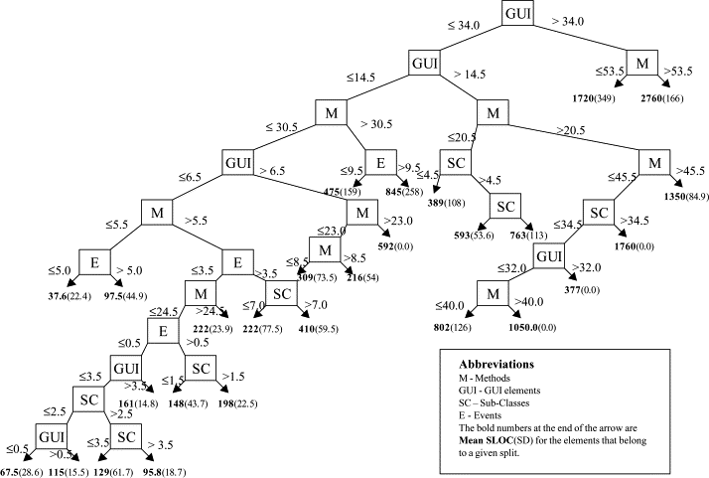
Regression Trees
Analysis of Object Oriented Software, Science Direct

Slide 16
Additional Resources
An Introduction to Categorical Data Analysis
  By ALAN AGRESTI
  Page 85
R Documentation:
  http://cran.r-project.org/web/packages/tree/tree.pdf

