Slide 1
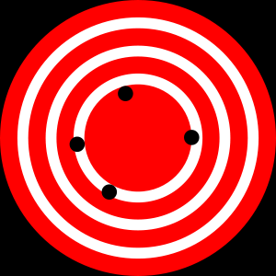

Accuracy and Precision
High Accuracy
Low Precision
Low Accuracy
High Precision
http://en.wikipedia.org/wiki/Accuracy_and_precision
Notes:
These are the formal terms, accuracy is often used to refer to uncertainty in general

Slide 2
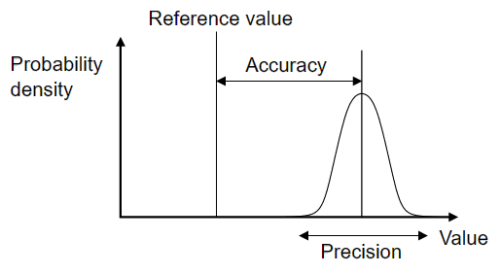
Accuracy and Precision
Accuracy = distance from truth
Precision = repeatability
Wikipedia

Slide 3
Precision
Estimate:
  Standard Deviation: Precision
  Standard Error: Precision
  Confidence Interval: Precision
  Min/Max: Precision
Manage:
  Significant Digits
  Data types: Doubles, Long Integers
Report

Slide 4
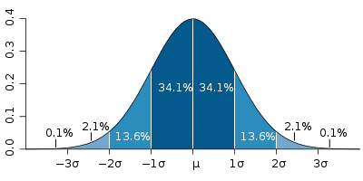
Standard Deviation (Precision)
Each band represents one standard deviation
Source: Wikipedia
Notes:
4

Slide 5
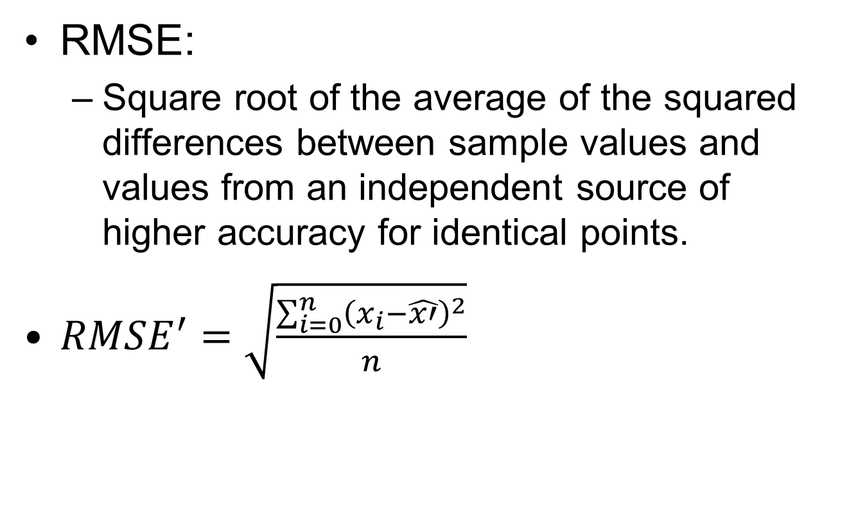
RMSE From Higher Accuracy

