Slide 1
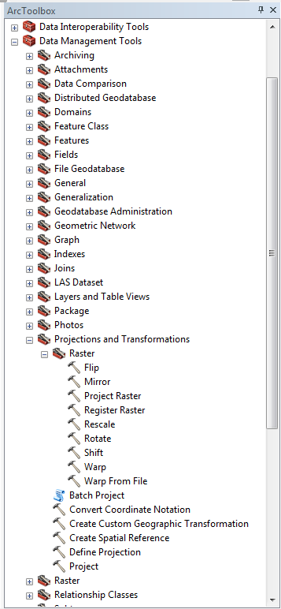
Project Raster Data to a new Spatial Reference
Define the Spatial Reference for any data
Project Vector Data to a new Spatial Reference

