Slide 1
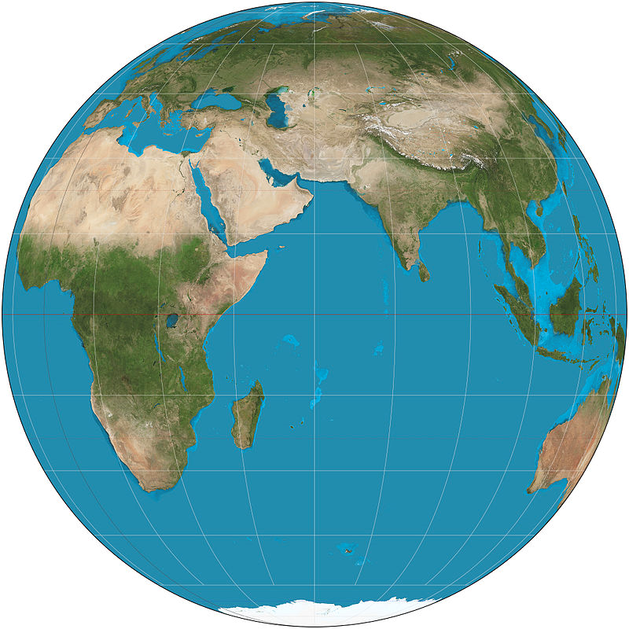
North Pole
Semi-minor
axis
Equator
Semi-major
axis
Earth (NASA)
South Pole

Slide 2
North Pole
90°
60°
30°
Parallels or “Lines of Latitude”
0°
Equator
-60°
-30°
South Pole
-90°

Slide 3
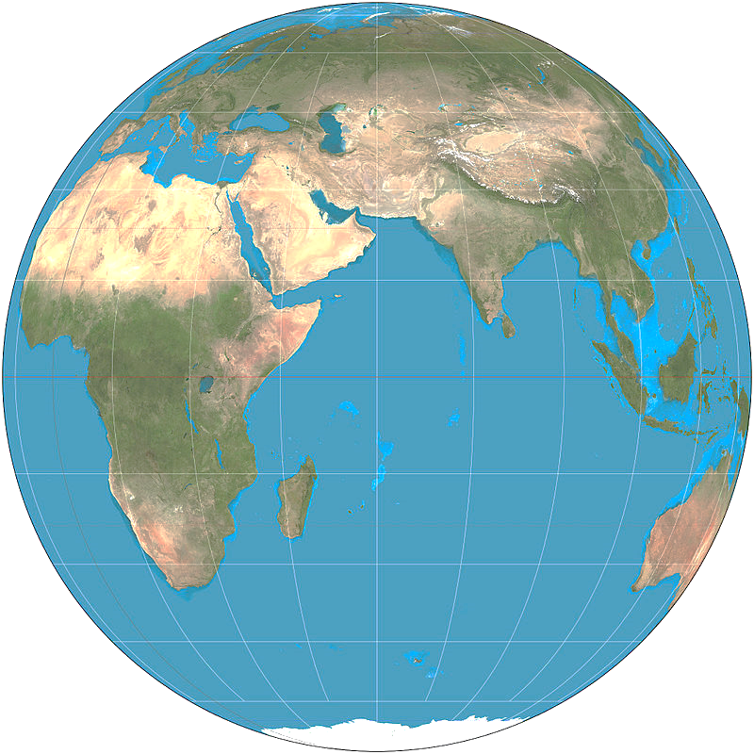
45°
Latitude

Slide 4
Prime Meridian
At Greenwich, England
Meridians or
“Lines of
Longitude
-90°
-60°
-30°
0°
30°
60°
90°

Slide 5
North Pole
Point of interest on the earth’s surface
Equator
Latitude
Equator
Longitude
South Pole

Slide 6
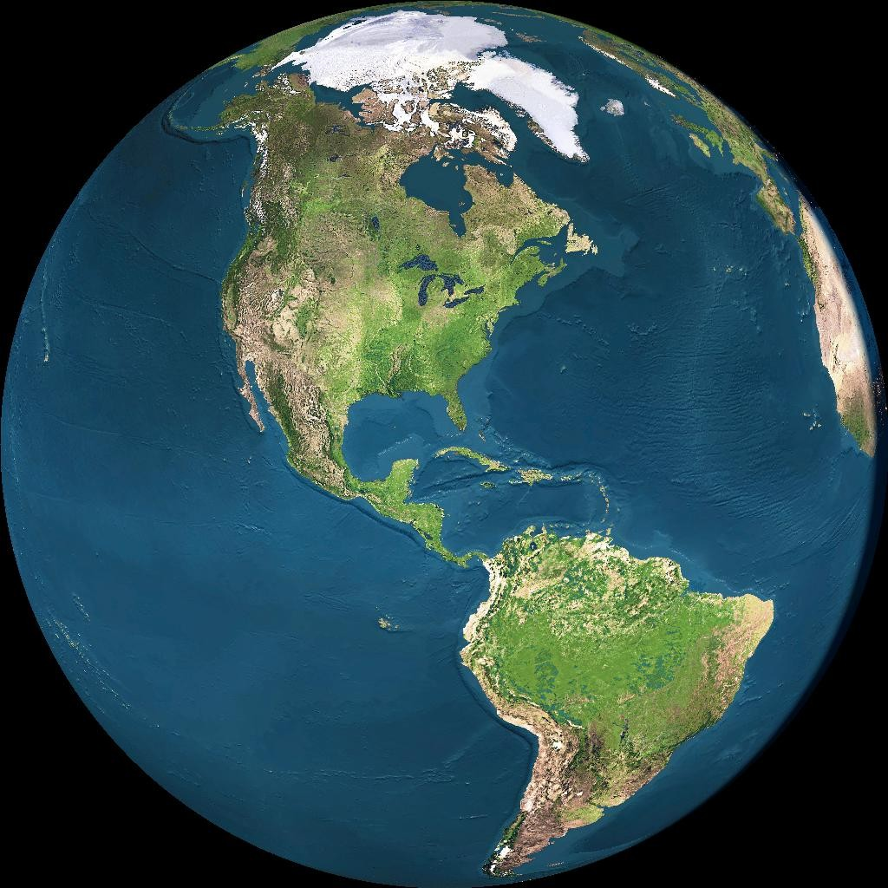

Slide 7
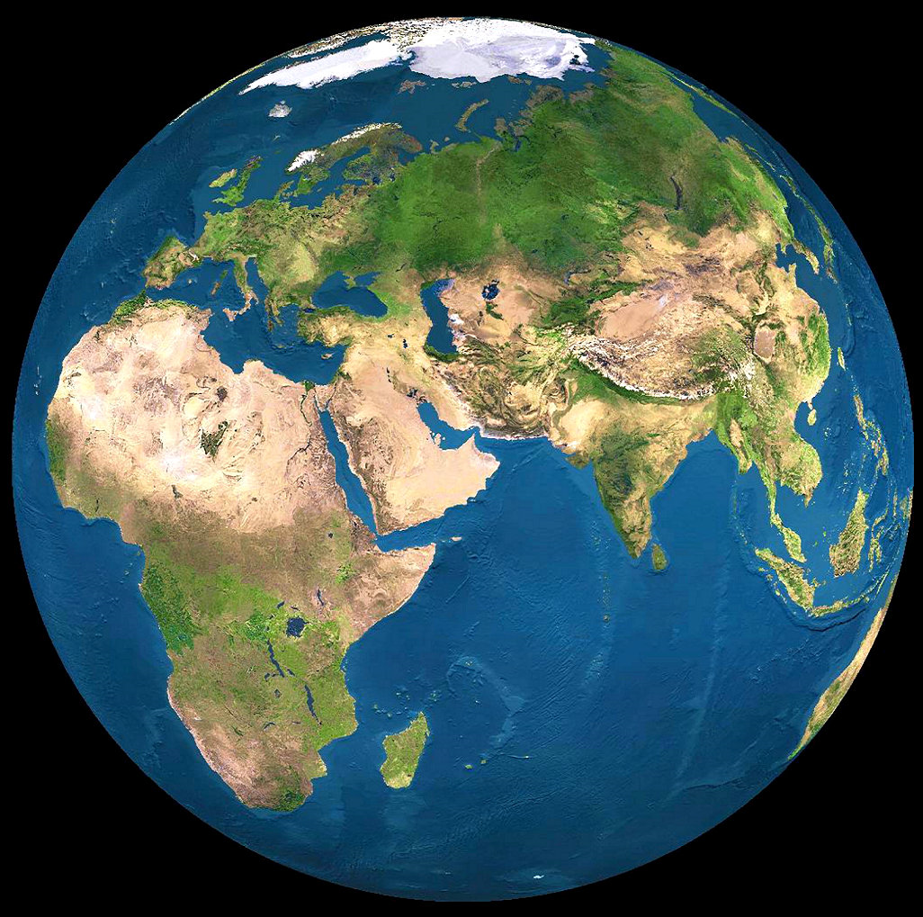
Point of
Interest
Latitude
Longitude
Equator
Prime Meridian

Slide 8
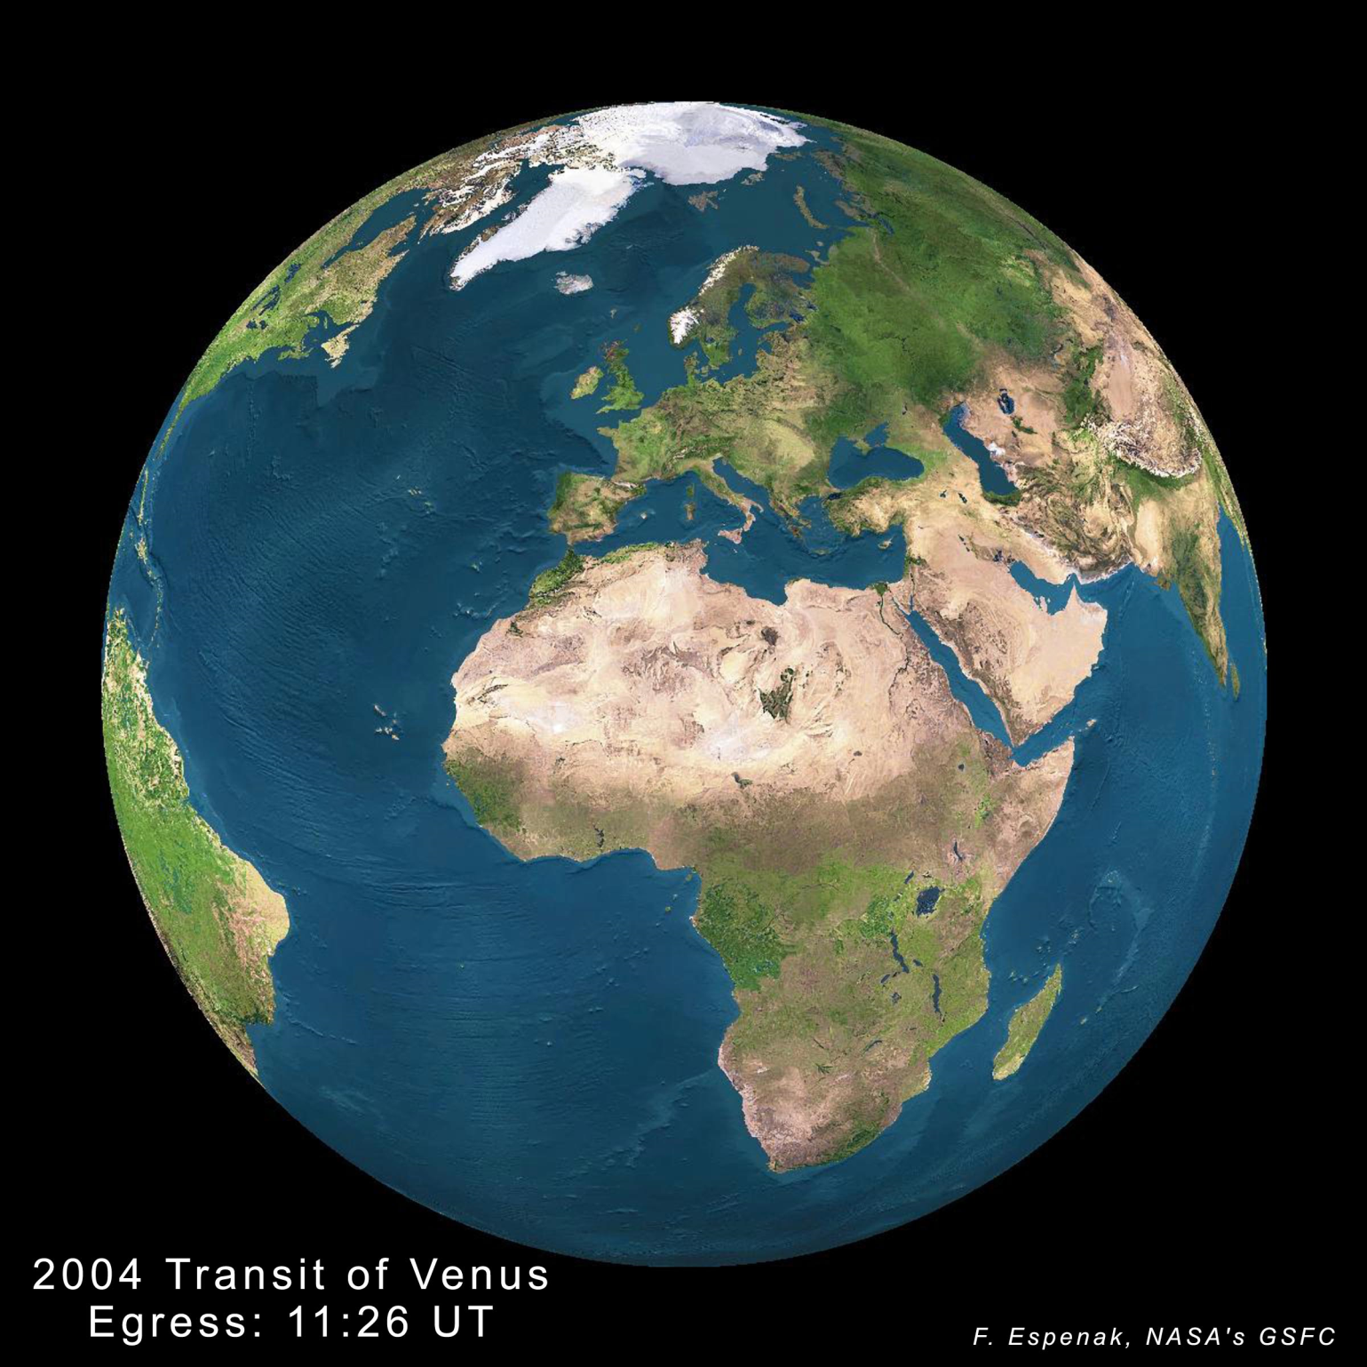

Slide 10
GCS
Datum
Prime Meridian (Greenwich)
Angular Units (Degrees)
PCS
Projection Method
Projection Parameters
Linear Units
GCS
Datum
Prime Meridian (Greenwich)
Angular Units (Degrees)

Slide 11
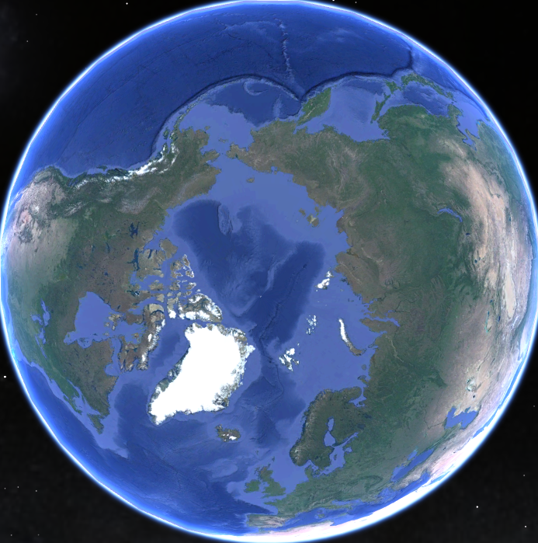
-180°
180°
-90°
90°
Prime Meridian:
0°

Slide 12
W 180°
E 180°
W 90°
E 90°
Prime Meridian:
0°

